Slide 1

Research Data Management (RDM) in Life Sciences
Matheus Lourenço, PhD
November 2025
Notes:
Manage expectations and main objective of the training:
1- This is an introductory course
2- For you to know ahead of time necessary steps and available resources for you to turn policy into action, benefiting your research

Slide 2

Before we begin
Computers are unnecessary for discussion moments
Computers open for exercises with closed apps (teams, outlook, WhatsApp, etc)
Notes:
Ground rules

Slide 3
First things first: Who we are
Notes:
Round of introductions.
Participants must also introduce themselves: name, position, have they published before.

Slide 4
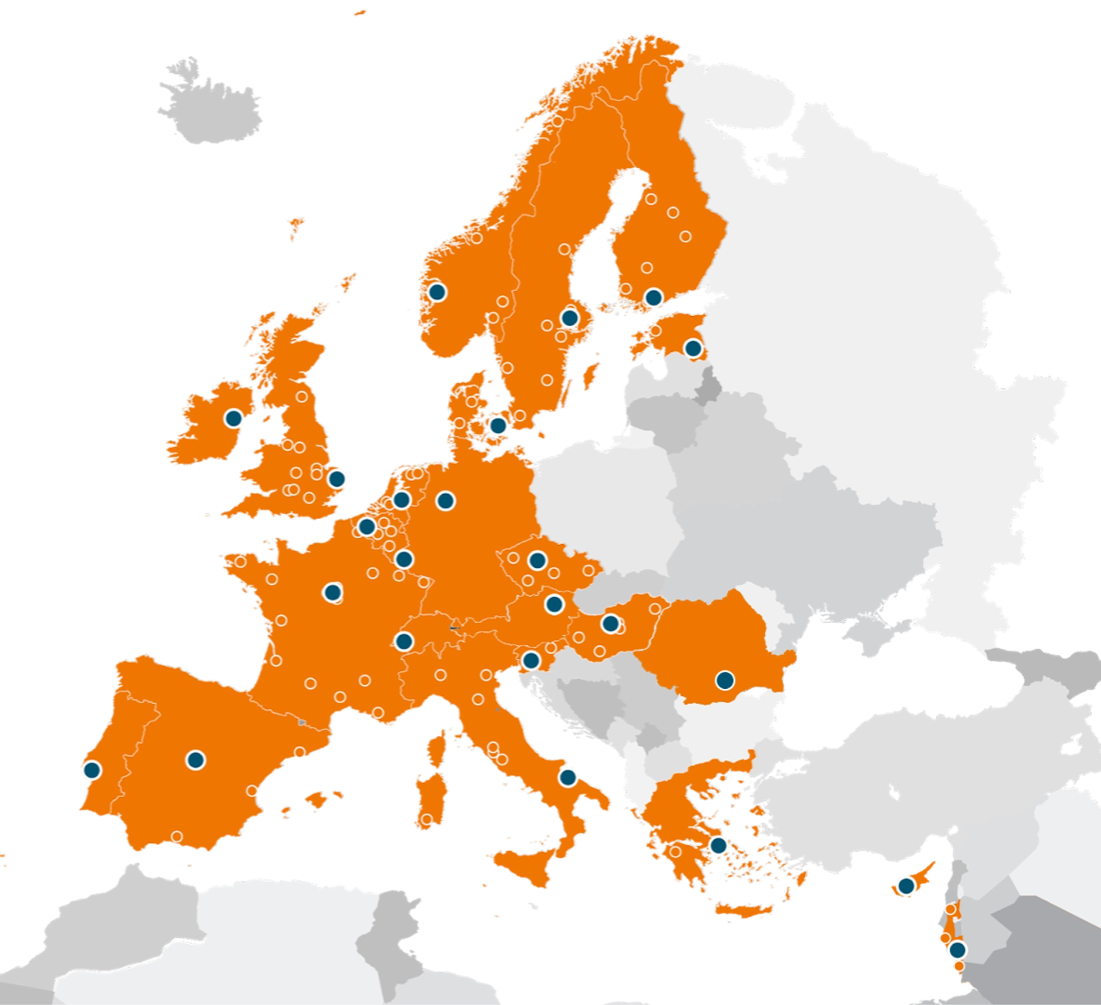
ELIXIR Europe and Elixir Belgium
Europe’s distributed infrastructure for life-science data.
Connects national nodes + EMBL-EBI to make data, tools, training, and compute Findable, Accessible, Interoperable, Reusable (FAIR).
Focus areas include data deposition, standards/metadata, cloud/compute, interoperability, and training.
The Belgian node coordinated by VIB with partners across Flemish and French-speaking universities & institutes.

Slide 5
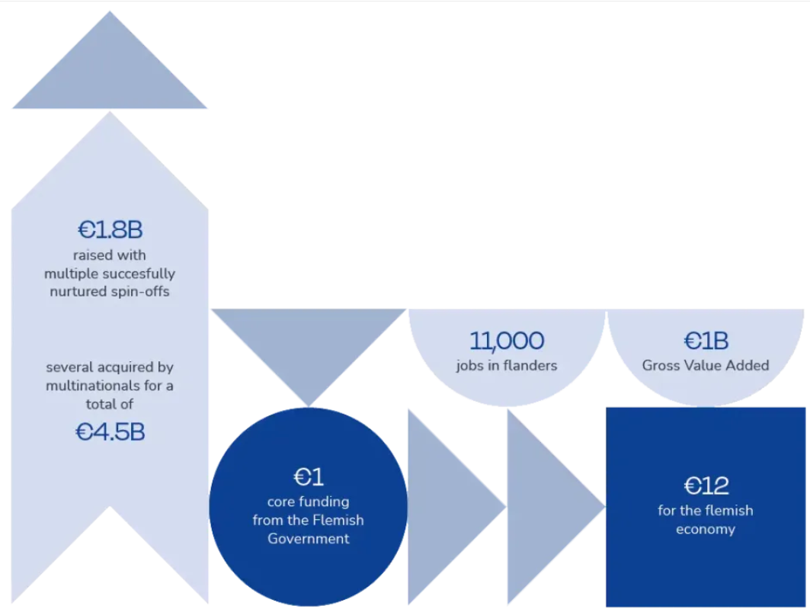


Slide 6

?

Slide 7
Research Data Management (RDM) in Life Sciences
Key terms and concepts
How to choose a repository
Break
Documentation and metadata
Folder organization
Notes:
First an agenda on the day
There are always short breaks between each session (5-10mins)

Slide 8
Key terms and concepts
Notes:
Manage expectations and main objective of the training:
1- This is an introductory course
2- For you to know ahead of time necessary steps and available resources for you to turn policy into action, benefiting your research

Slide 9
Key terms and concepts
RDM and its lifecycle
FAIR Principles
What is a DMP
Why

Slide 10
01
RDM and its lifecycle
Notes:
Start with “post it” exercise (encourage people to stand up and be active early): What is RDM?

Slide 11
One term at a time
Research:
The systematic investigation into and study of materials and sources in order to establish facts and reach new conclusions
Data:
Any recorded information (whether on purpose or not)
Management:
The process of dealing with or controlling things or people
Process:
A series of actions or steps taken in order to achieve a particular end
Notes:
Takeaway message: RDM is a series of actions taken to control recorded info that is used in a systematic investigation.

Slide 12
One term at a time
Research:
The systematic investigation into and study of materials and sources in order to establish facts and reach new conclusions
Data:
Any recorded information (whether on purpose or not)
Management:
The process of dealing with or controlling things or people
Process:
A series of actions or steps taken in order to achieve a particular end
Notes:
Takeaway message: RDM is a series of actions taken to control recorded info that is used in a systematic investigation.

Slide 13
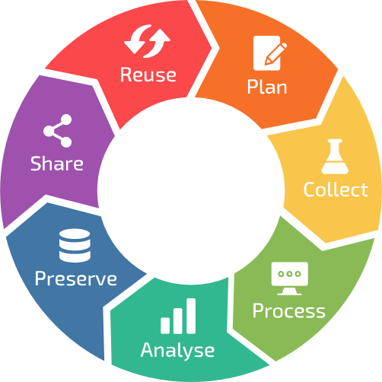
The RDM lifecycle
Where and which actions take place in each phase of the RDM cycle?
Notes:
Discussion moment: start to gather simple examples from the participants on RDM practices.
How having a lifecyle is helpful.
Link to next topic (FAIR): why would you want to do good RDM?

Slide 14
02
FAIR Principles

Slide 15




The FAIR principles

Slide 16
Findable
Metadata
keywords
identifiers
machine-actionable (SEO, etc)
Access procedure
e.g., DAC
authentication, identification
…
Accessible
Interoperable
Standards
Ontologies
For humans and machines
Re-usable
Documentation
Licence
Notes:
Quick introduction on FAIR and how it can manifest with the side examples (which will be tackled during the day).

Slide 17
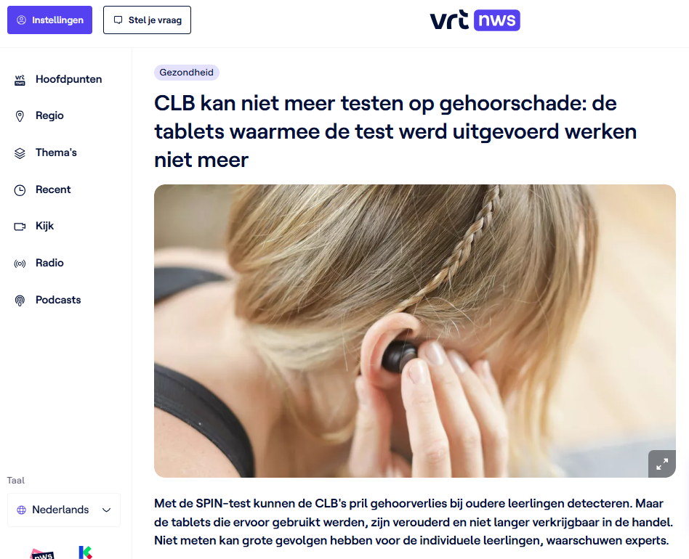
Real world consequences
Summary: Flemish students are temporarily no longer being tested for hearing damage because the tablets used for the SPIN-test (Speech In Noise) have become outdated and are no longer available. This interruption may lead to missed early detection of hearing loss, with potential long-term consequences for students' academic performance and future opportunities.
What missing FAIR principle is illustrated by this story?
Notes:
Discussion moment.
Question for the audience: When do you think this happened? (Answer: reported on Sept 12, 2025). Highlight recency and impact.

Slide 18
Summary
All the actions that you take to control your data throughout its lifecycle to ensure that they are FAIR.

Slide 19
04
What is a DMP

Slide 20
DMPs help make RDM tangible
DMPs make RDM less abstract by making you think about all aspects related to your data
Questions on:
description of data and their associated explanatory metadata;
storage and long-term preservation of the data;
designation of responsible persons;
indication of costs involved;
handling of sensitive data;
open access to and sharing of research data.​

Slide 21


DMP funder policies
Funder | Proposal | Initial DMP (month 6) | Final DMP (end of project)
FWO | Answer 6 RDM questions
EOS | Answer 6 RDM questions
BOF/IOF
BELSPO | Provisional DMP
Horizon Europe | RDM for FAIR data and Open Science practices
H2020 | RDM for FAIR data

Slide 22
Lifecycle of DMPs
Proposal Stage Input​
Researchers answer preliminary data management questions to outline initial data handling plans. This helps funders assess project feasibility and responsibility.​
Initial DMP Submission​
Within six months, researchers submit detailed plans covering data types, formats, storage, metadata, and ethical compliance such as GDPR.​
Mid-Term Updates​
DMP is updated to reflect changes in data collection, collaborations, or sharing strategies, keeping the plan responsive and current.​
Final DMP Submission​
At project end, a final DMP confirms data management, preservation, and accessibility, ensuring long-term stewardship and open science compliance.​

Slide 23
DMP: first version
Data Management Plan First submission
First scope of reusability.
Basic information about your data.
Data storage and back up vs. long term preservation.
Initial idea about metadata standards and dedicated archive / repository.
Identification of legal and/or ethical issues.
Establishing responsibilities.
Adapted from: Jasmin Böhmer. (2019, September). UBC RDM Workshop 1 - Data Management Planning (Version V2). Zenodo. http://doi.org/10.5281/zenodo.3469953

Slide 24
DMP: first version vs. last version
Data Management Plan First submission
Data Management Plan Final submission
First scope of reusability.
Basic information about your data.
Data storage and back up vs. long term preservation.
Initial idea about metadata standards and dedicated archive / repository.
Identification of legal and/or ethical issues.
Establishing responsibilities.
Definite selection of reusable outputs.
Precise description of all data types.
Clear long-term preservation strategy: selected data archive(s) and/or repository(ies).
FAIR data and open data (“As open as possible, as closed as necessary”).
Adapted from: Jasmin Böhmer. (2019, September). UBC RDM Workshop 1 - Data Management Planning (Version V2). Zenodo. http://doi.org/10.5281/zenodo.3469953

Slide 25
Aspects of a DMP
Data summary / description
Ethical and legal issues
Documentation and metadata
Resources and Responsibilities
Data sharing and reuse
Data storage during the project
Long-term preservation

Slide 26
Aspects of a DMP
Data summary / description
Ethical and legal issues
Documentation and metadata
Resources and Responsibilities
Data sharing and reuse
Data storage during the project
Long-term preservation
Purpose, origin, type, format & volume of the data
List and describe all datasets or research materials that you plan to generate/collect or reuse during your research project.
If you reuse existing data, please specify the source, preferably by using a persistent identifier (e.g. DOI, Handle, URL etc.) per dataset or data type

Slide 27
Aspects of a DMP
Data summary / description
Ethical and legal issues
Documentation and metadata
Resources and Responsibilities
Data sharing and reuse
Data storage during the project
Long-term preservation
Purpose, origin, type, format & volume of the data
Take into account the diversity in data types:
Survey
Measurement
Observation
Code
Image
Document
Visualisation

Slide 28
Aspects of a DMP
Data summary / description
Ethical and legal issues
Documentation and metadata
Resources and Responsibilities
Data sharing and reuse
Data storage during the project
Long-term preservation
Purpose, origin, type, format & volume of the data
Only provide answers relating to research data, not publications!
Clear distinction between re-used and new data.
Break down and list your data types conveniently: e.g. by technique, by purpose, by research phase.
Provide enough details for outsiders to understand the sort of data involved

Slide 29
Aspects of a DMP
Data summary / description
Ethical and legal issues
Documentation and metadata
Resources and Responsibilities
Data sharing and reuse
Data storage during the project
Long-term preservation
IRB approval, IP, GDPR
Will you process personal data? If so, briefly describe the kind of personal data you will use in the comment section.
Are there any ethical issues concerning the creation and/or use of the data (e.g. experiments on humans or animals, dual use)?

Slide 30
Aspects of a DMP
Data summary / description
Ethical and legal issues
Documentation and metadata
Resources and Responsibilities
Data sharing and reuse
Data storage during the project
Long-term preservation
IRB approval, IP, GDPR
Does your work have potential for commercial valorization (e.g. tech transfer, for example spin-offs, commercial exploitation, …)?
Do existing 3rd party agreements restrict dissemination or exploitation of the data you (re)use?
Are there any other legal issues, such as intellectual property rights and ownership, to be managed related to the data you (re)use?

Slide 31
Aspects of a DMP
Data summary / description
Ethical and legal issues
Documentation and metadata
Resources and Responsibilities
Data sharing and reuse
Data storage during the project
Long-term preservation
Where and how, standards, ontologies, vocabularies
What approach will be followed to capture the accompanying information necessary to keep data understandable and usable, for yourself and others, now and in the future.
Will a metadata standard be used to make it easier to find and reuse the data?

Slide 32
Aspects of a DMP
Data summary / description
Ethical and legal issues
Documentation and metadata
Resources and Responsibilities
Data sharing and reuse
Data storage during the project
Long-term preservation
Costs
Owner and roles
Where will data be stored?
How will the data be backed up?
How will you ensure that the data are securely stored and not accessed or modified by unauthorised persons?

Slide 33
Aspects of a DMP
Data summary / description
Ethical and legal issues
Documentation and metadata
Resources and Responsibilities
Data sharing and reuse
Data storage during the project
Long-term preservation
Costs
Owner and roles
Who will manage data documentation and metadata during the research project?
Who will manage data storage and backup during the research project?
Who will manage data preservation and sharing?
Who will update and implement this DMP?

Slide 34
Aspects of a DMP
Data summary / description
Ethical and legal issues
Documentation and metadata
Resources and Responsibilities
Data sharing and reuse
Data storage during the project
Long-term preservation
Repositories, terms, contracts, licenses
Will the data (or part of the data) be made available for reuse after/during the project?
If access is restricted, please specify who will be able to access the data and under what conditions.
Are there any factors that restrict or prevent the sharing of (some of) the data (e.g. as defined in an agreement with a 3rd party, legal restrictions)?

Slide 35
Aspects of a DMP
Data summary / description
Ethical and legal issues
Documentation and metadata
Resources and Responsibilities
Data sharing and reuse
Data storage during the project
Long-term preservation
Security, back-up, transfer & access
Where will data be stored?
How will the data be backed up?
Is there sufficient storage & backup capacity during the project?
What are the expected costs for data storage & backup during the project? How will these costs be covered?
How will you ensure that the data are securely stored and not accessed or modified by unauthorised persons?

Slide 36
Aspects of a DMP
Data summary / description
Ethical and legal issues
Documentation and metadata
Resources and Responsibilities
Data sharing and reuse
Data storage during the project
Long-term preservation
What, where, restrictions?
Which data will be retained for the expected 5-year period after the end of the project? In case some data cannot be preserved, clearly state the reasons for this.
Other terms apply to Clinical trials, patient records, ‘experiments’, …
Where will these data be archived (= stored and curated for the long term)?

Slide 37
Aspects of a DMP
Data summary / description
Ethical and legal issues
Documentation and metadata
Resources and Responsibilities
Data sharing and reuse
Data storage during the project
Long-term preservation
What, where, restrictions?
Purpose, origin, type, format & volume of the data
IRB approval, IP, GDPR
Where and how, standards, ontologies, vocabularies
Costs
Repositories, terms, contracts, licenses
Security, back-up, transfer & access
Owner and roles
DMP

Slide 38
04
Why

Slide 39
Carrot or stick?
Notes:
Reasons to be FAIR and to proper GDPR.
For the next slides let’s think about benefits and negative consequences.

Slide 40
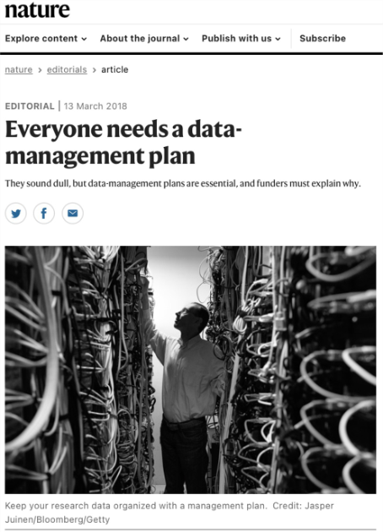
Essential
For funders (i.e. DMP, open, data, etc)
For journals: No data, no paper
How much are scientists trusted?

Slide 41
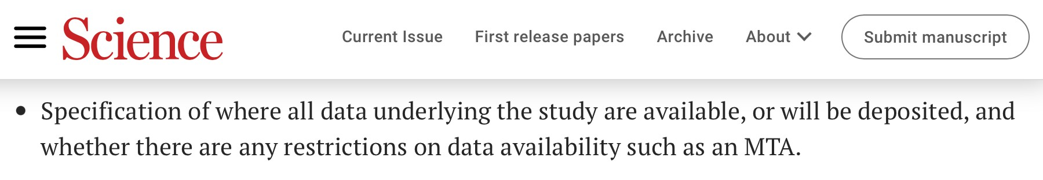
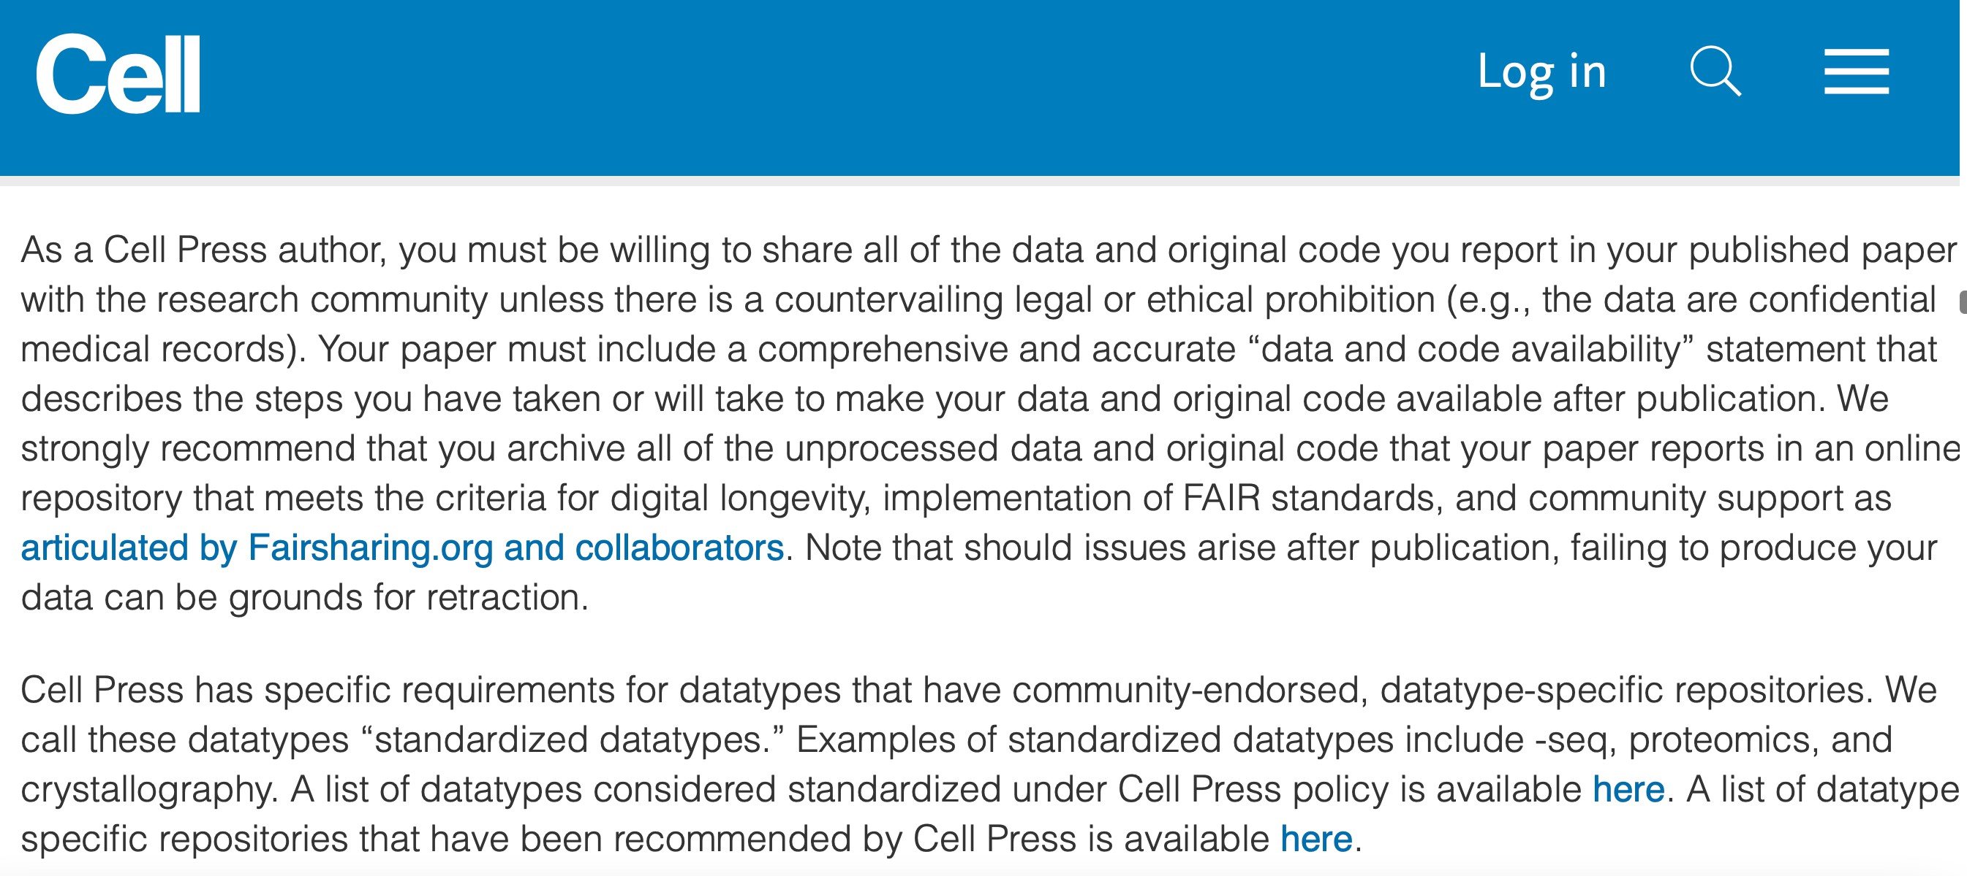
Journals request FAIR data
https://www.science.org/content/page/science-information-authors
https://www.cell.com/cell/authors

Slide 42
Some benefits
Reduce the risk of data loss​
Less time (and money) spent​
Increase efficiency and smooth collaboration in a team (easier and faster way for sharing information)​
More control over data access (who, when, how, etc.)​
More clear documentation for people onboarding the team and by
people leave the team​
Easier data reuse (samples, raw data, scripts, analysis etc.)​
Notes:
Discussion moment: have you ever thought ‘what did I do with that data?’

Slide 43
Other benefits
Transparent and trustworthy data and science (and paper)
Higher impact in scientific community
More citations​
New discoveries at a lower cost by reusing high quality existing data​
Less duplication of work​
Notes:
Discussion moment: have you ever thought ‘what did I do with that data?’

Slide 44
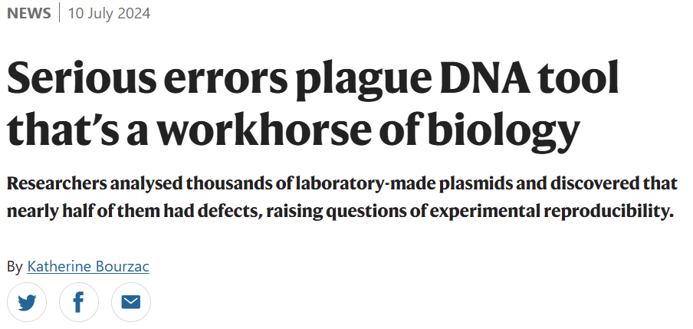
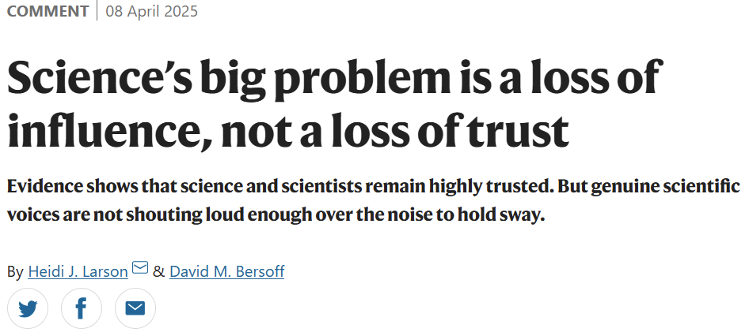
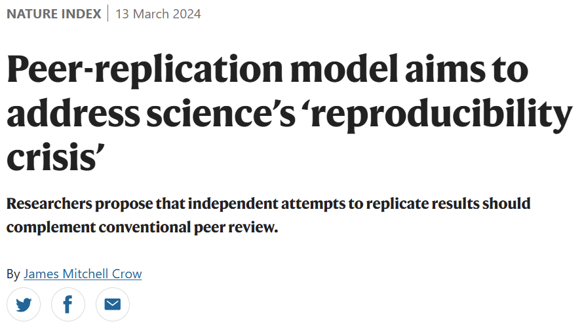
Scientific Integrity
Why are you in science?
What about the reproducibility crisis?
Strengthen public trust through communication.

Slide 45
Experiment replicability

Slide 46
Carrot or stick?
Notes:
Reflection: identification of participants as VIB researchers (high standards expected)

Slide 47
How to choose a repository

Slide 48
Disclaimer: I will not tell you which repository to use in your research.
!

Slide 49
How to choose a repository
Basic definitions
Why use a repository
How to find repositories
How to choose a repository
A word on re-usability

Slide 50
01
Basic definitions

Slide 51
Basic definitions
Deposit/depose
The act of submitting research data and associated metadata into a repository.
Repository
A digital platform or infrastructure designed to store, manage, and provide access to research data.
Retention
Mainly policy related, referring to how long data is kept and the reappraisal once the initial retention period expires.
Preservation
Focuses on the act of preserving data. In other words, active care required to ensure continued access to and usability of digital materials for as long as needed.

Slide 52
02
Why

Slide 53
Where to start?

Slide 54
Carrot or stick?

Slide 55
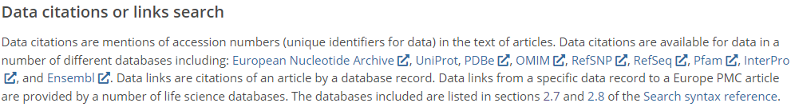
The carrot approach
Future proofing for yourself
Increased citations:
https://europepmc.org/Help#searchdata

Slide 56
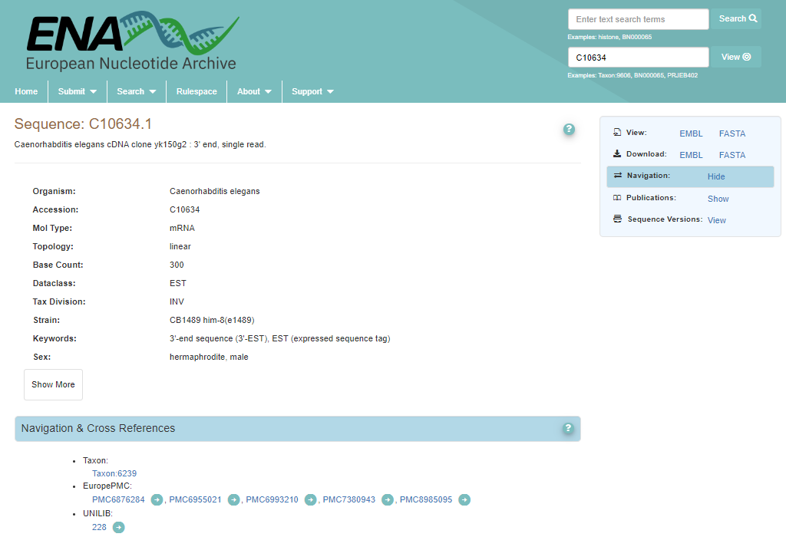
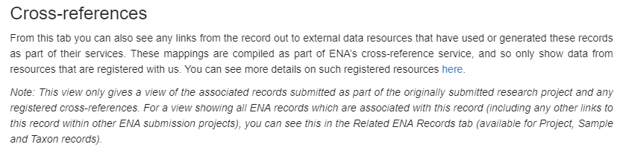
Example:

Slide 57
The carrot approach
Future proofing for yourself
Increased citations:
Visibility and networking possibilities
In other words: You want to do it!
https://europepmc.org/Help#searchdata

Slide 58
03
How to find repositories

Slide 59

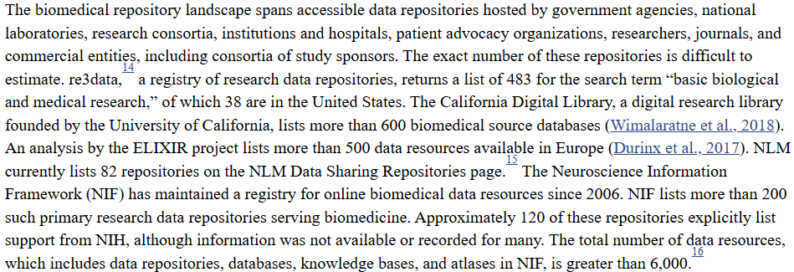
There are hundreds of repositories available
Introduction - Life-Cycle Decisions for Biomedical Data - NCBI Bookshelf (2020)

Slide 60
Tools for finding repositories
Re3data.org
Fairsharing.org
Elixir-Europe.org/platforms/data/elixir-deposition-databases
Ebi.ac.uk/submission/
AI (e.g. co-pilot)
Etc… (check RDMkit for more)

Slide 61

Notes:
Ground rules

Slide 62
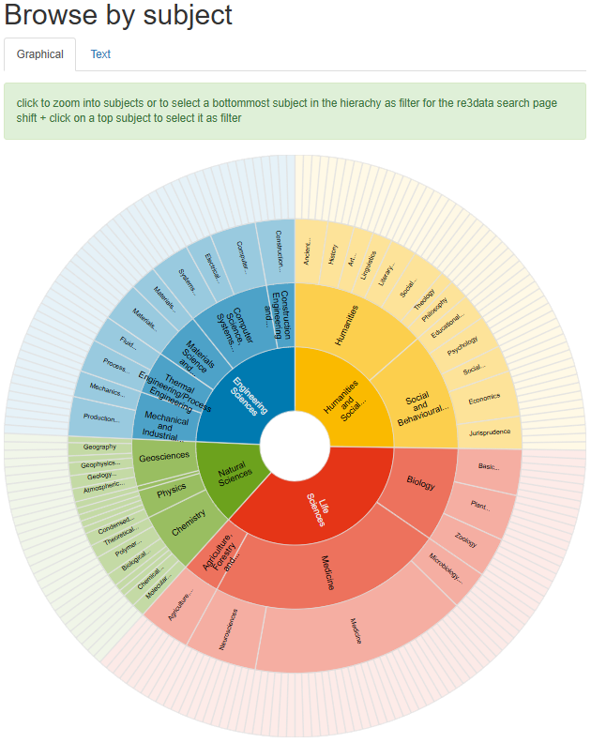

Go to and explore the number of repositories in your field

Slide 63
Notes:
Ground rules

Slide 64
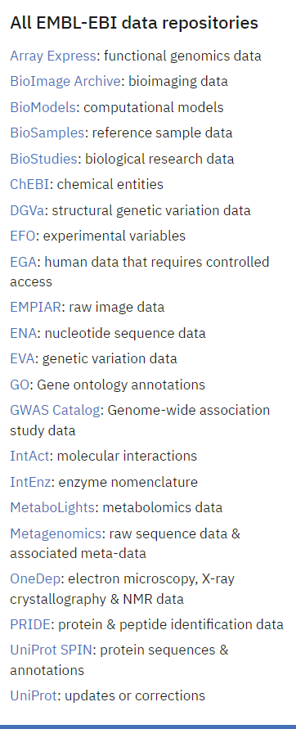

The data wizard:

Slide 65
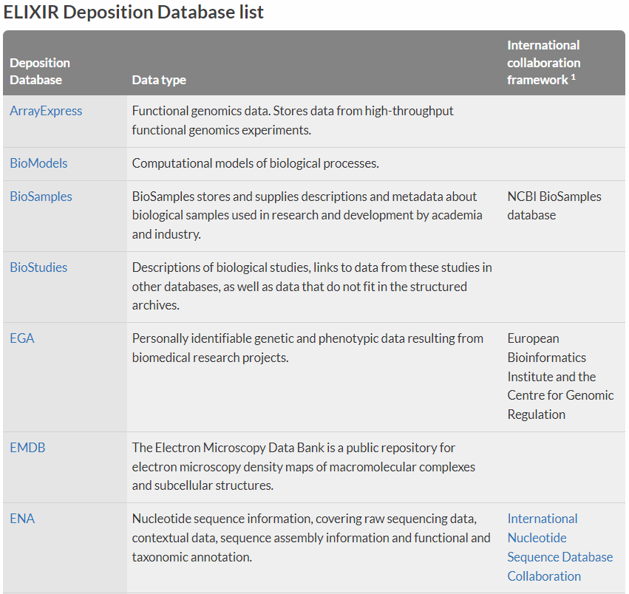
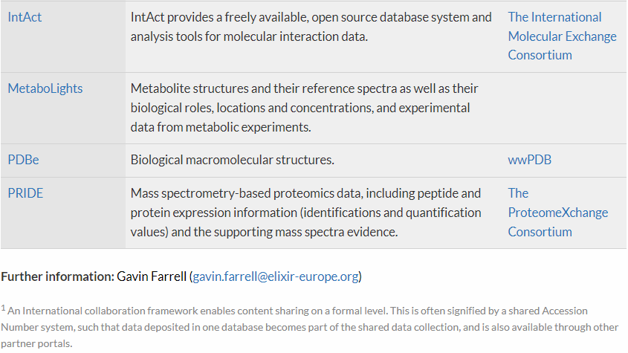
ELIXIR Deposition Database list
ELIXIR Deposition Databases for Biomolecular Data | ELIXIR (2017)

Slide 66
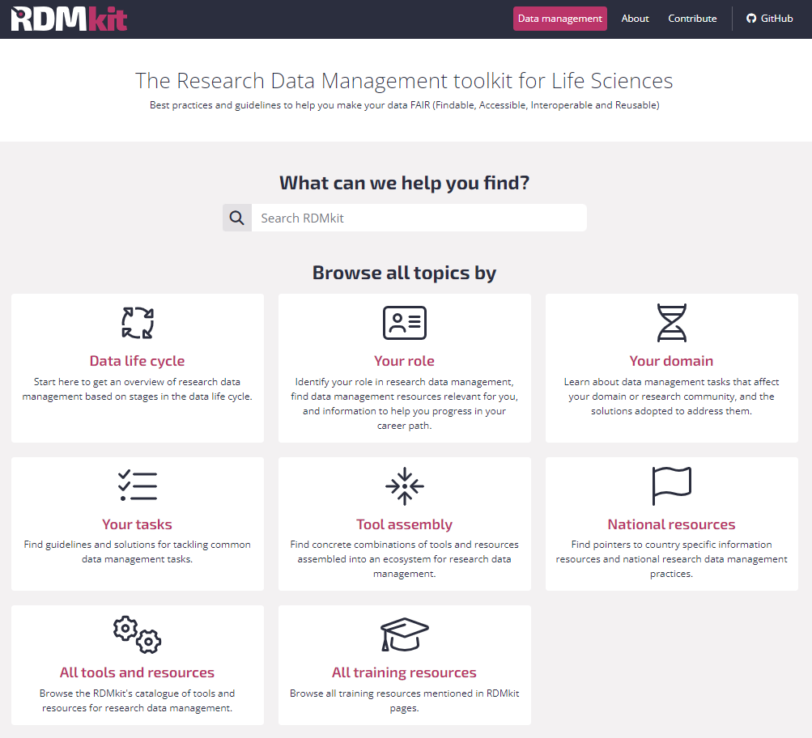

Community driven:

Slide 67
Notes:
Ground rules

Slide 68
Alice
She is a researcher who:
Works with plants
Is generating whole genome sequencing data
Makes use of several public platforms for tools and data
Has the current project funded by a public agency
Aims at publishing work in an open peer reviewed journal
Suggest a couple of repositories based on the RDMkit that are domain specific
Justify your choice
Think about what info you can find about the repository

Slide 69
Notes:
Ground rules

Slide 70
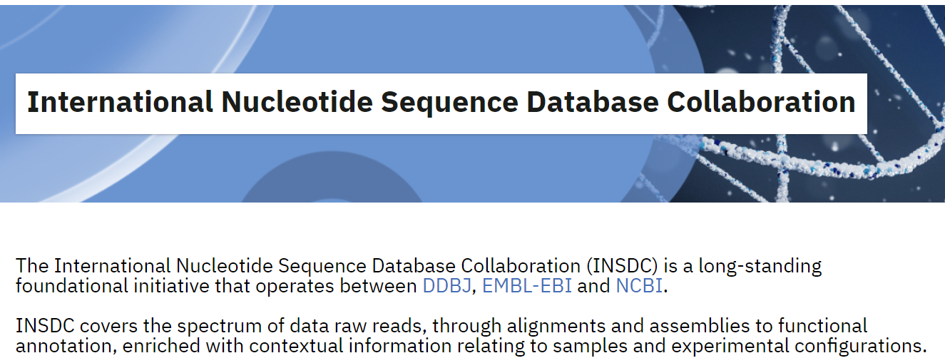
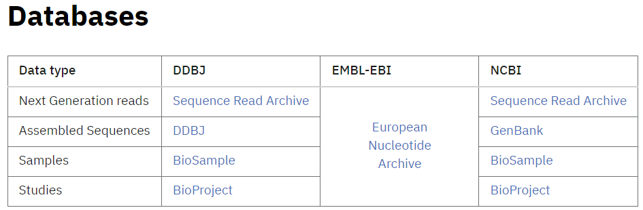
Multiple repositories with similar data type
https://www.insdc.org/

Slide 71



Genomics

Slide 72
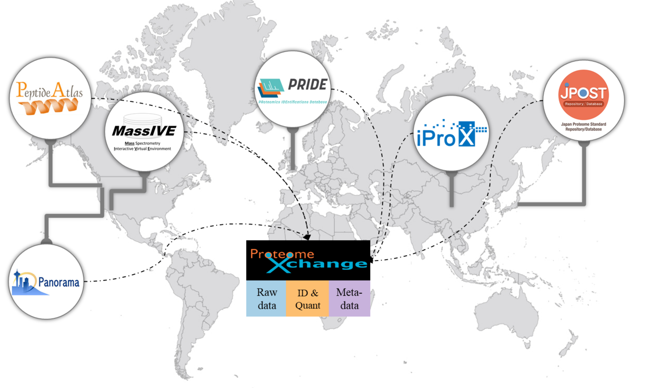
Proteomics
proteomexchange.org

Slide 73

Metabolomics
MetabolomeXchange

Slide 74


The Omics Discovery Index (OmicsDI)
OmicsDI is part of the ELIXIR infrastructure
25 Resources, >3M datasets, 4 Continents

Slide 75
Notes:
Ground rules

Slide 76
Alice is back
Still working with plants
Is generating whole genome sequencing data
Makes use of several public platforms for tools and data
Has the current project funded by a public agency
Aims at publishing work in an open peer reviewed journal
Is also generating proteomics data
Is also generating metabolomics data
Would like that the datasets are recognized as to belonging to the same project
Find suitable domain specific repositories and a way to connect these datasets

Slide 77
Notes:
Ground rules

Slide 78



Multi-omics

Slide 79



Multi-omics
BioSamples
BioSamples
BioSamples
BioSamples

Slide 80

Multi-omics
BioSamples
BioSamples
BioSamples
BioSamples

Slide 81

A side note on human sensitive data
“a service for permanent archiving and sharing of personally identifiable genetic, phenotypic, and clinical data generated for the purposes of biomedical research projects or in the context of research-focused healthcare systems.”
!
Data access defined, including Data Access Committees (DAC). Different datasets may have different DACs.

Slide 82
Access types
Open access: Data is shared publicly. To use open-access researchers need to ensure that the data is anonymized, which is difficult and sometimes impossible in practice.
Registered access: Data is shared with researchers, who have been vouched for by their institution and who agree to abide by data usage policies. Datasets that are shared via registered-access would typically have no restrictions besides the condition that data is to be used for research.
Controlled access: Access is reviewed and approved by a data access committee (DAC). Typically, researchers who were involved in the primary collection of data will form the DAC. There can be a multitude of usage conditions, including allowed research topics, geographical regions, and recipients e.g. non-profit organizations.
At VIB, a DAC may already have been created. Always check with René Custers: rene.custers@vib.be

Slide 83
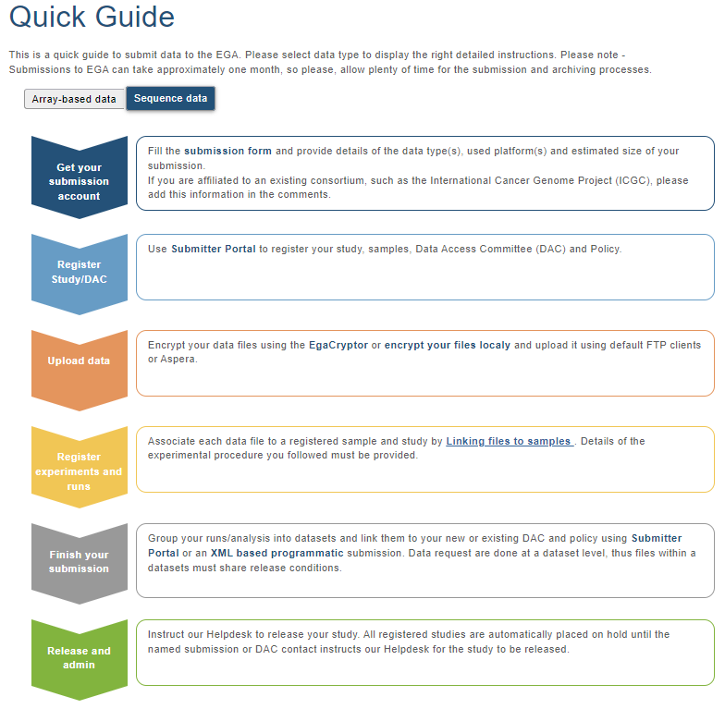
Submitting data to the EGA
https://ega-archive.org/submission/quickguide

Slide 84

A Federated option
The data does not leave the Local EGA (i.e. your country), while it is still discoverable through the Central EGA

Slide 85
Global examples
Repository | Purpose | Example Use
BioSamples | Metadata for biological samples | Sample tracking across studies
BioStudies | Project-level metadata | Linking datasets to publications
ENA | Nucleotide sequence archive | Genomic data sharing
EGA | Controlled-access human data | Sensitive health/genomic data

Slide 86
Brazilian equivalents
Initiative | Equivalent to | Description
ABraOM | ENA / EGA | Genomic data from Brazilian elderly population
Genomas Brasil | EGA | National sequencing initiative (100k genomes)
GBB (Genomics of Brazilian Biodiversity) | BioSamples | Genomic mapping of native species
LNBio | BioStudies | National lab supporting omics & imaging data
PCDaS (Fiocruz) | EGA / BioStudies | Secure health data platform for research

Slide 87
04
How to choose a repository

Slide 88
Do you have to choose?
?
University requirements
Journal requirements
DMP requirements
Funding requirements
Ethical and legal requirements

Slide 89
If you do have to choose
Think strategically
Think about your selected audience
Think about how general vs specific you want to go
Think about your values

Slide 90

Can you trust it?
CoreTrustSeal – Core Trustworthy Data Repositories
In order to provide some guidance to researchers and data stewards, the CoreTrustSeal has 16 requirements which repositories must answer to.
Over 160 repositories are certified.

Slide 91
An example:
A single study has the following topics within it:
Tinnitus treatment
Cognitive Behaviour Therapy
Data on Ecological Momentary Assessment (EMA)
Data on n-of-1 trials
In which journal should you publish the data?
Which repository should you use?

Slide 92
Before you submit!
Different repositories have different rules:
What files are expected?
What metadata is expected?
Can ontologies and controlled vocabularies be used?
Are costs involved?
Is there a license requirement (or is it implicit)?

Slide 93
Before you submit!
Different repositories have different rules:
What files are expected?
What metadata is expected?
Can ontologies and controlled vocabularies be used?
Are costs involved?
Is there a license requirement (or is it implicit)?

Slide 94
05
A word on re-usability

Slide 95
3523580 unknown entries in OmicsDI
!

Slide 96
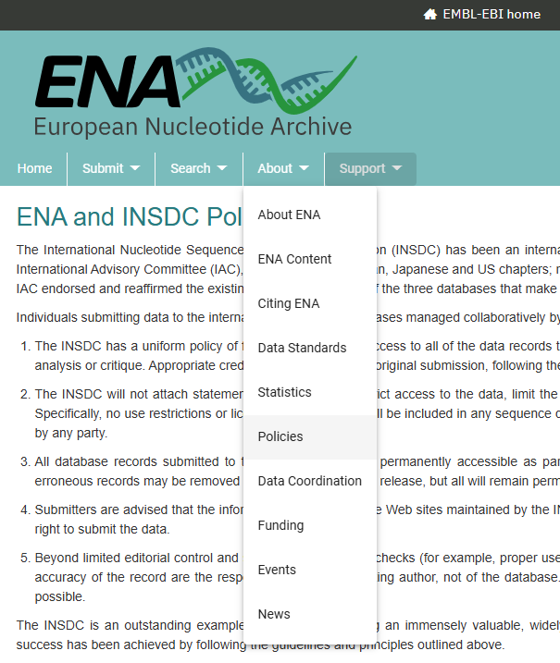
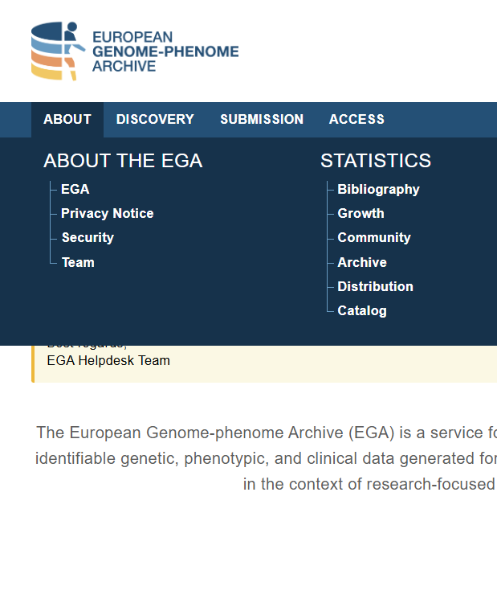
Check licenses for re-use and before submitting

Slide 97
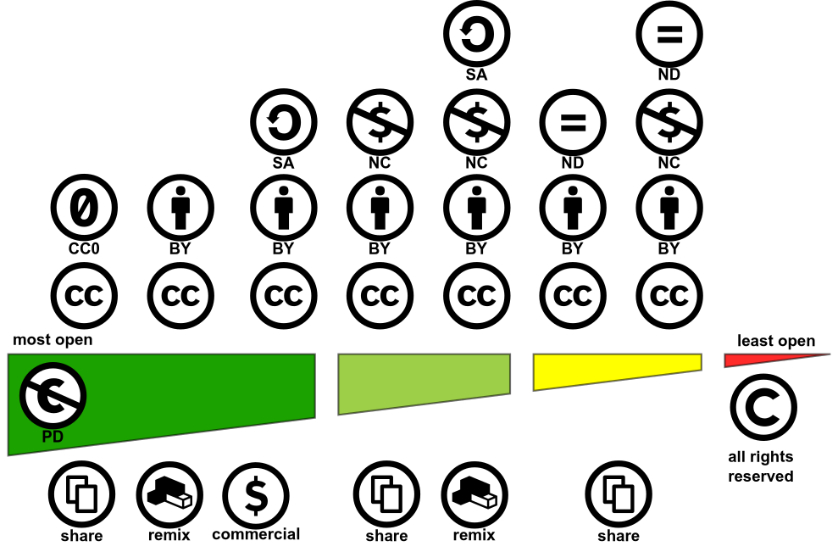

Creative Commons: A license for you
https://creativecommons.org/choose

Slide 98
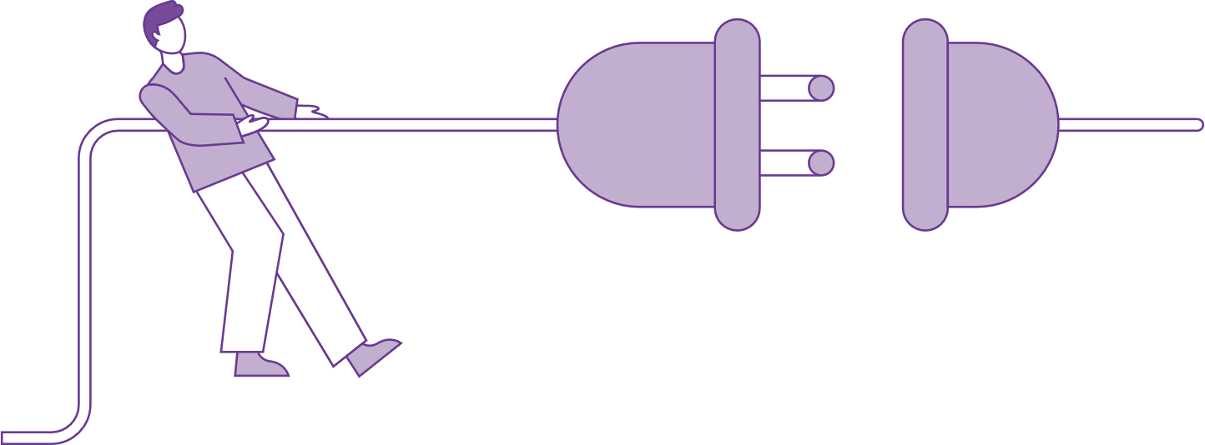
Break
Disconnect for 15 mins

Slide 99
Documentation and metadata

Slide 100
Documentation and metadata
Data description
Documentation and metadata
Controlled vocabulary
Folder structure

Slide 101
01
Data description

Slide 102
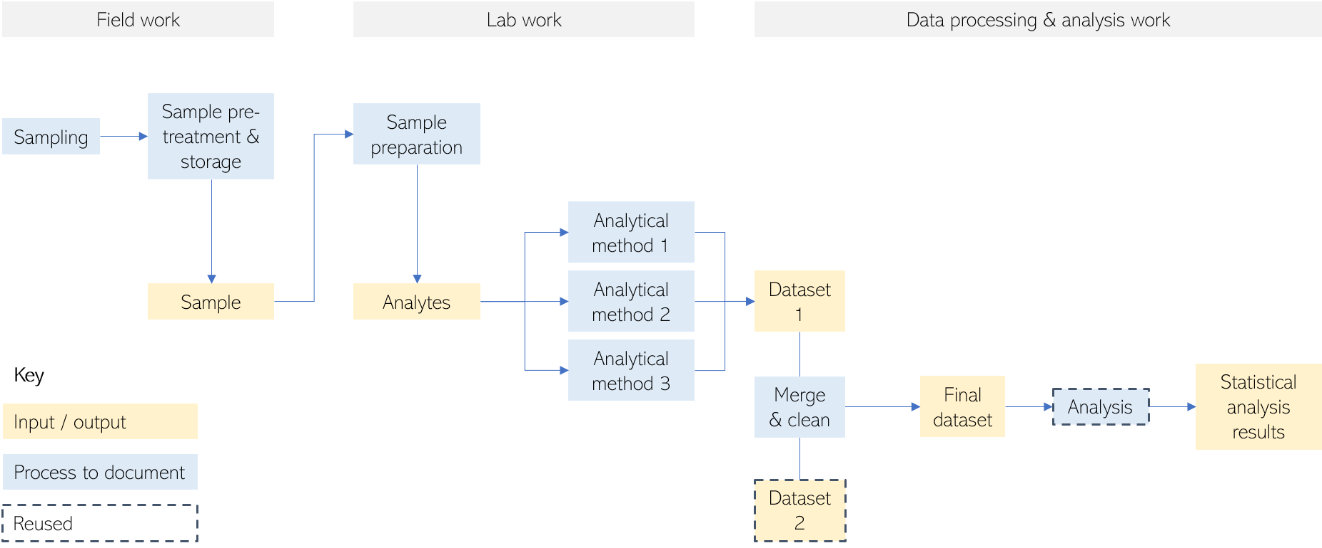
Data workflow: generic example

Slide 103







Data Description: different approaches
Write a data description paragraph
Build a project data workflow
Prepare a data summary table
Complex project structure, small to medium number of data types.
To visualize data as input & outputs + the different processing and analysis steps.
Can help in other RDM steps: file organization & naming, documentation.
Complex project structure, medium to large number of data types.
Data sets and/or types as rows, with characteristics as columns.
To detect RDM needs: e.g. additional storage space needed, confidential data…
Straightforward project structure
Limited number of data types

Slide 104
Data overview table in FWO/cSBO VLAIO DMP
Data overview tables are a useful way to index all the data/outputs in the project and refer to them in other parts of DMP
 |  |  |  | Only for digital data | Only for digital data | Only for physical data
Dataset Reference | Description | New or reused | Data Type | Digital Data format | Digital data volume (MB/GB/TB) | Physical volume
 |  | Please choose from the following options: Generate new data Reuse existing data | Please choose from the following options: Audiovisual Numerical Image Model Software Text Workflow Physical object Other | For example: .csv, .pdf, .txt | Please choose from the following options: < 100MB < 1GB < 2 TB … NA

Slide 105
Data overview
Rows (i.e. datasets, data types)
Which methods do you use to collect data?
Why are you collecting the data?
What type of data is it? Content? Format? Physical or digital?
Is it raw data or processed data?
Columns (i.e. characteristics of the data)
Is there any pre-existing data that you will be using?
What is the source of the pre-existing data?
Will you be collecting physical materials?
Which methods will you use to collect/generate new data?
Which data is confidential? Personal data? 3rd party data?
What is the expected size of the data?
Which file/data formats will you be using? Are they open and sustainable?

Slide 106
Time to get your hands dirty

Slide 107
02
Documentation and metadata

Slide 108






Documentation
WHY?
Facilitate research review, verification and reproducibility.
Enable data to be found, understood and reused.
WHAT
WHO
WHY
WHERE
WHEN
HOW

Slide 109


Levels of data documentation
DOCUMENTATION LEVEL
WHAT TO DOCUMENT
WHERE TO DOCUMENT
Item
Variable
Methods, units, possible values,
synonyms, abbreviations
Codebook, data dictionary
Sample
Study object
Study object, method, instrument
settings, time, place
(Register) table, protocol, notebook
File or database
File inventory and relations, database structure
Readme, database schema,
data listings (qualitative data)
Project or study
Subject, grant, contributors, methods, process, workflow
Notebook (e-, code), document, protocol, readme, data inventory table
https://www.ugent.be/en/research/datamanagement/during-research/documentation.htm

Slide 110
Documentation guidelines Minimal information about a … experiment
For example MINSEQE (Minimum Information About a Next-generation Sequencing Experiment) guidelines
This includes:
Raw data for each assay (e.g., FASTQ files)
Final processed (normalized) data for the set of assays in the study (e.g., the gene expression data count matrix used to draw the conclusions in the study)
Essential sample annotation (e.g., tissue, sex and age) and the experimental factors and their values (e.g., compound and dose in a dose response study)
Experimental design including sample data relationships (e.g., which raw data file relates to which sample, which assays are technical, which are biological replicates)
Sufficient annotation of the array or sequence features examined (e.g., gene identifiers, genomic coordinates)
Essential laboratory and data processing protocols (e.g., what normalization method has been used to obtain the final processed data)
https://en.wikipedia.org/wiki/Minimum_information_standard

Slide 111
Documentation vs. Metadata
DOCUMENTATION
Any contextual information that allows data to be understandable and reusable.
METADATA
Information about data, in a highly structured way, using a set of defined fields to be machine readable.
The dataset…
llllllllllllllll lllllllllllll
Title
llllllllllllllll lllllllllllll
lllllllllllllllllllllllllllllllllll
llllllllll llllllllllllllllll
Creator
lllllllllll lllllllllll
Abstract
lllllllllllllllllllllllllllllllllll
llllllllll llllllllllllllllll
Keywords
llllllllllllllllllll lllllllllllllll
Temporal scope
llllllllllllllllllll
File type
llllllll
License
lllllllllllll
Related publication
llllllllllllllllllllllllllllllllll
llllllllllllllll llllllllllllll

Slide 112
Find me:
White closet
2m wide
MDF
2m tall

Slide 113
Metadata standards: generic vs. discipline specific
Metadata standard: when a community agrees on a set of metadata fields or elements, obligatoriness & cardinality, their meaning, allowed values (e.g. from a list of controlled vocabularies) & formats.
Discipline standards: to satisfy the needs of a particular scientific domain.
Typically contain additional elements & rules.
DataCite
EML (Ecologic Metadata Language)
*Identifier
packageID
Used in discipline- specific data repositories (e.g. GBIF)
Generic fields used in domain-agnostic data repositories
*Creator
creator
*Title
title
*PublicationYear
pubDate
GeoLocation
geographicCoverage
n/a
taxonomicCoverage

Slide 114

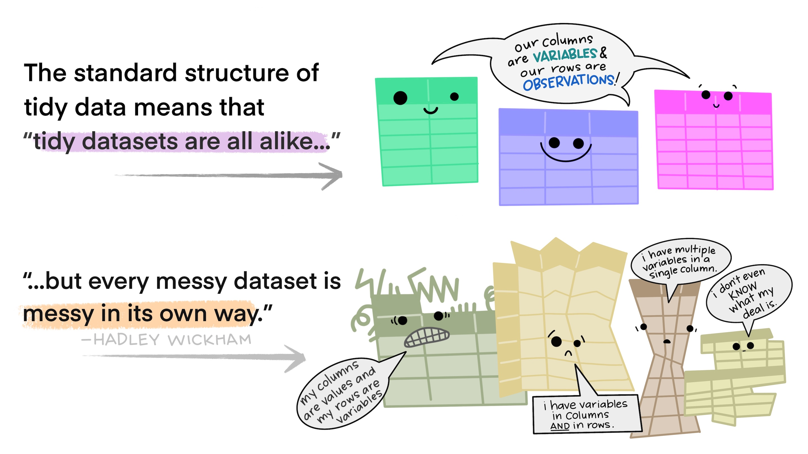
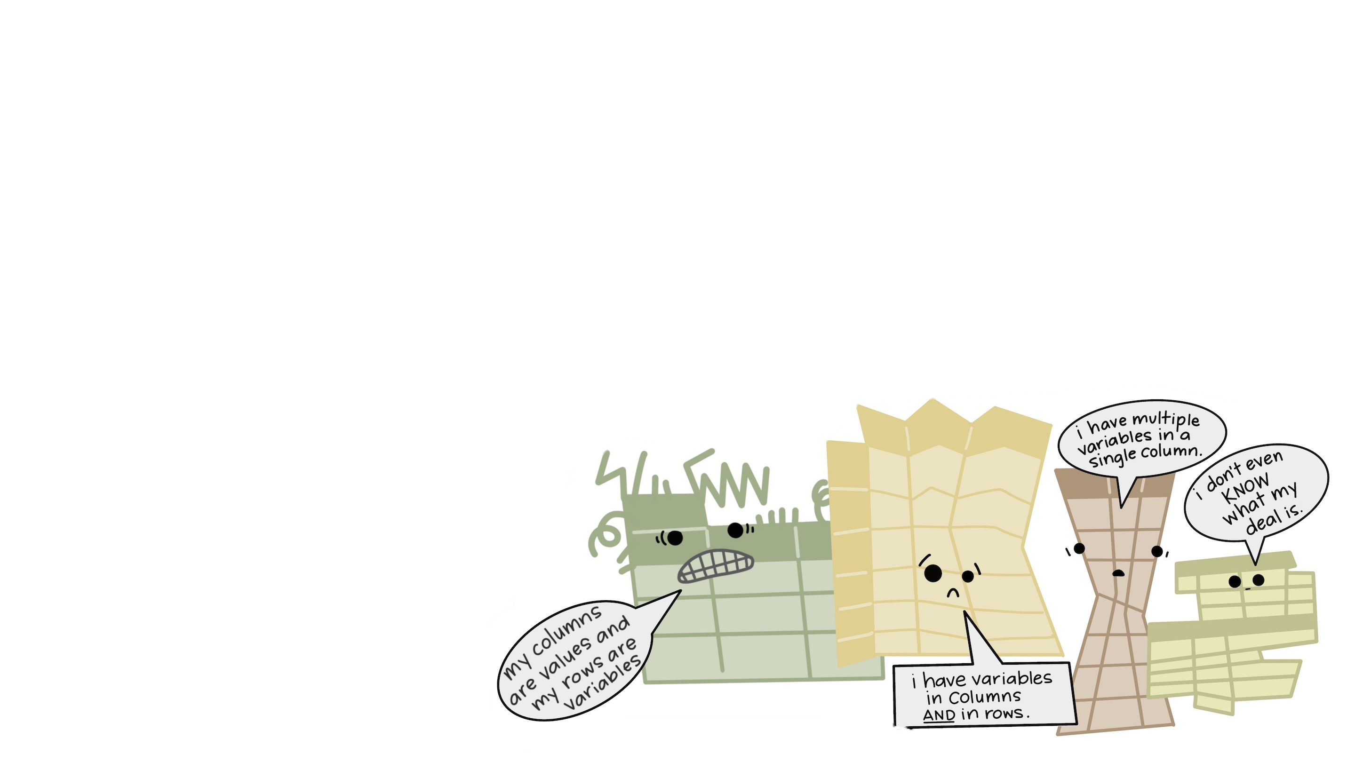
Common issues on understandability
May, 4th?
ISO standard (YYYYMMDD or YYYY-MM-DD)
1985-04-05
April,5th?
05/04/85

Slide 115
What colour is this?

Slide 116
Appelblauwzeegroen

Slide 117
What colour is this?
Write it down
Discuss with your peers
Find one answer with the room
What about: appelblauwzeegroen?
No? Sure? Then what?
Let’s search it online and compare.
Notes:
Does the computer understand your choice? Is it the same?
What if you have a large colourful grid? Or a specific image? Maybe you used a contrast? Etc
How do you isolate that specific colour?

Slide 118
03
Controlled vocabulary

Slide 119





Standards & Controlled vocabularies
Standards: Rules that govern how data is structured, formatted, shared, and exchanged across systems.
Controlled vocabularies: Define agreed-upon terms to ensure consistency in describing variables, values, units, etc.
Why?
兩
2
Unambiguity
Everyone uses the same terms for the same concepts
Interoperability
Data from different researchers and disciplines can be easily integrated
Machine actionability
Computers can process data more effectively when data is standardized

Slide 120
Vocabularies in life sciences
In clinical context often referred to as 'coding’ (e.g. hospital setting disease coding)
Clinical medicine: https://prsinfo.clinicaltrials.gov/definitions.html
Clinical ontologies in REDCap: http://bioportal.bioontology.org/
Clinical established vocabularies or ontologies
e.g. as listed in https://www.ebi.ac.uk/ols/index
or agreed terminology such as ICD-10, SNOMED, …
Bioassay ontology, eg for small molecule screening
https://bioportal.bioontology.org/ontologies/BAO
The EGA recommends using the Experimental Factor Ontology Database for describing your sample phenotypes and MONDO for disease classification
Example dataset on EGA: https://ega-archive.org/datasets/EGAD00001000002

Slide 121

Standardized metadata
Metadata fields or
elements
Metadata values
Vocabularies, ontologies, ISO standards
Title
llllllllllllllll lllllllllllll
Creator
ORCID
Description
lllllllllllllllllllllllllllllllllll
llllllllll llllllllllllllllll
Subject
llllllllllllllllllll lllllllllllllll
Date
ISO-…
Format
llllllll
Rights
lllllllllllll
Related identifier
llllllllllllllllllllllllllllllllll
llllllllllllllll llllllllllllll

Slide 122
04
Folder structure

Slide 123
Sub-chapters
Why
How
Format
Organization
Naming
Versioning

Slide 124
Why?

Slide 125
S*** happens

Slide 126
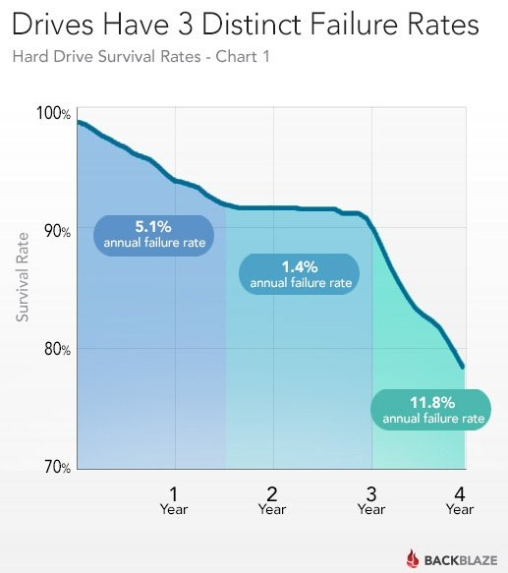
Like:
Fire
Theft
Hacking
Failure
So keep it in a cloud!

Slide 127
Choosing a format

Slide 128





Choosing a file format
A file format describes how information is stored (“encoded”) within a digital file
Can be recognized by file extension (e.g. *.docx, *.jpg, *.pdf)
Choosing a file format might be influenced by different factors:
Domain norms & software
Previous work & colleagues
Hardware & instrumentation
Facilitate collaboration
Vulnerability to obsolescence
Notes:
What is a file format?
A file format determines how information is stored (or "encoded") within a digital file.
Examples can be identified by their file extensions, such as .docx, .jpg, .pdf.
Factors influencing file format choice:
Domain norms & software: Some fields have preferred formats (e.g., .fasta for bioinformatics or .dicom for medical imaging).
Previous work & colleagues: Consistency with existing data or ensuring compatibility with collaborators' tools.
Hardware & instrumentation: Certain formats are dictated by the equipment or software used to generate the data.
Facilitate collaboration: Choosing formats that are widely used and accessible ensures smoother collaboration.
Vulnerability to obsolescence: Consider whether the format is likely to become outdated or if it will remain accessible in the future.
Key takeaway:
Choosing the right file format is essential for data compatibility, longevity, and collaboration.

Slide 129






Open vs. closed
CLOSED FORMATS
OPEN FORMATS
Proprietary
Dependence on third-party software
Limited compatibility between versions
High vulnerability to obsolescence
Proprietary &
non-proprietary
Platform and software independent: maximize interoperability & reuse
Compatibility between versions by design
Low vulnerability to obsolescence
Icons made by Freepik from www.flaticon.com
Notes:
Closed Formats
Definition: Proprietary formats controlled by specific companies or organizations.
Characteristics:
Dependence on third-party software to access or edit files (e.g., WMA, PSD).
Limited compatibility between different software versions.
High vulnerability to obsolescence, as the format might not be supported in the future.
Open Formats
Definition: Formats that are platform- and software-independent, designed for interoperability and reuse.
Characteristics:
Can be either proprietary or non-proprietary but are widely accessible (e.g., PDF, CSV, PNG, TIFF).
Platform and software independent, maximizing usability across tools.
Designed for compatibility between versions to ensure long-term accessibility.
Low vulnerability to obsolescence, making them better for archiving and sharing.
Key takeaway
Use open formats whenever possible, especially for sharing and archiving data, to ensure compatibility and future access.
Rely on closed formats only when necessary, such as for specific tools or workflows.

Slide 130








file migration & compression
Possible loss of content, metadata & quality
Be aware of the risks
Keep a copy of the original
Check & repair damage
Loss of formulas, embedded charts & comments, visual formatting…
Other problems: multiple tables in worksheet, not rectangular tables, merged cells, dates…
Lossless compression formats: allows the original data to be perfectly reconstructed from the compressed data
Lossy compression: uses inexact approximations and partial data discarding to represent the content.
Notes:
Sometimes we might need to migrate files to a different format. How can be make sure we preserve data quality?
File migration risks
Possible loss of content, metadata, and quality:
For example, converting XLSX to CSV:
Loss of formulas, embedded charts, comments, and visual formatting.
Other issues: Misalignment due to multiple tables, merged cells, or dates not properly formatted.
Strategies:
Always keep a copy of the original file to revert to in case of data loss.
Check and repair damage after migration to ensure the integrity of the data.
Compression types
Lossless compression:
Formats like TIFF allow perfect reconstruction of the original data after decompression.
Useful for data where quality and accuracy must be maintained (e.g., research data or high-quality images).
Lossy compression:
Formats like JPG use approximations, discarding some data to reduce file size.
Suitable for applications where slight quality loss is acceptable (e.g., web images).
Key takeaways
Always be aware of the risks when migrating or compressing files.
Use lossless formats for critical data and lossy formats when smaller file sizes are more important than precision.
Regularly validate the integrity of migrated or compressed files.

Slide 131
Domain specific data format standards: examples
FITS (.fits): Flexible Image Transport System, widely used for storing astronomical data, images, and metadata
ASCII (.txt): Simple, plain text format for data sharing.
CIF (.cif): Crystallographic Information File for crystal structure data.
MOL (.mol, .sdf): Representations of molecules and chemical structures.
GeoTIFF (.tif, .tiff): Tagged Image File Format with georeferencing information, used in GIS and remote sensing.
Shapefile (.shp, .shx, .dbf): Standard format for vector data (points, lines, polygons) in GIS.
NetCDF (.nc): Network Common Data Format, used for multidimensional geospatial datasets like climate models.
DEM (.dem): Digital Elevation Model, used for topography and terrain analysis.
FASTA (.fasta, .fa): Text-based format for nucleotide or amino acid sequences.
MATLAB (.mat, .m): Proprietary format for computational models, simulations, and data analysis.
AutoCAD (.dwg, .dxf):Proprietary formats for engineering drawings and architectural plans.
Notes:
In NS + BSE
FITS (.fits): Flexible Image Transport System, widely used for storing astronomical data, images, and metadata
ASCII (.txt): Simple, plain text format for data sharing.
CIF (.cif): Crystallographic Information File for crystal structure data.
MOL (.mol, .sdf): Representations of molecules and chemical structures.
GeoTIFF (.tif, .tiff): Tagged Image File Format with georeferencing information, used in GIS and remote sensing.
Shapefile (.shp, .shx, .dbf): Standard format for vector data (points, lines, polygons) in GIS.
NetCDF (.nc): Network Common Data Format, used for multidimensional geospatial datasets like climate models.
DEM (.dem): Digital Elevation Model, used for topography and terrain analysis.
FASTA (.fasta, .fa):Text-based format for nucleotide or amino acid sequences.
MATLAB (.mat, .m):Proprietary format for computational models, simulations, and data analysis.
AutoCAD (.dwg, .dxf):Proprietary formats for engineering drawings and architectural plans.

Slide 132
Organization

Slide 133
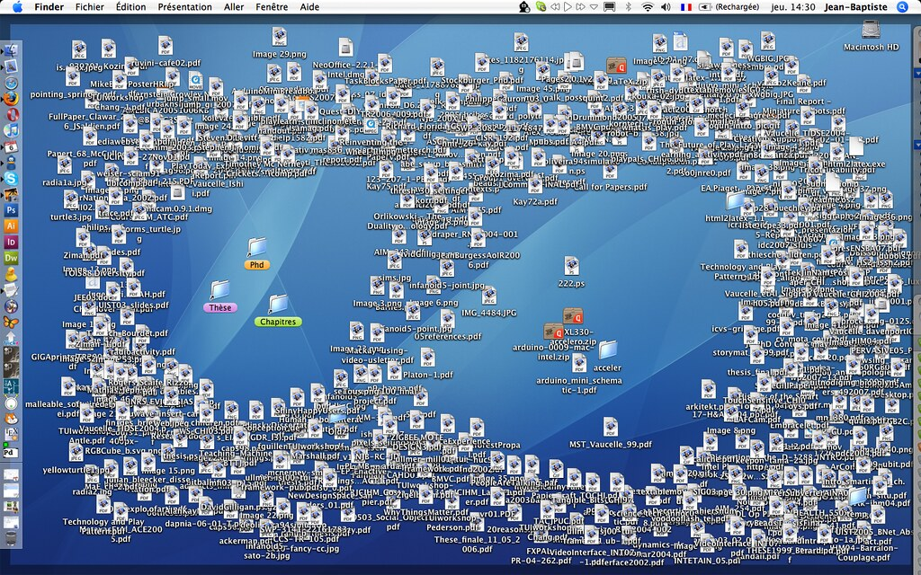
Notes:
Challenges of poor file organization:
Cluttered workspace: A disorganized desktop makes it difficult to locate files quickly.
Inefficient workflows: Wastes time searching for the correct document or resource.
Risk of data loss: Important files may accidentally be deleted or overlooked.
Stress and frustration: A messy digital environment can negatively affect productivity and focus.

Slide 134
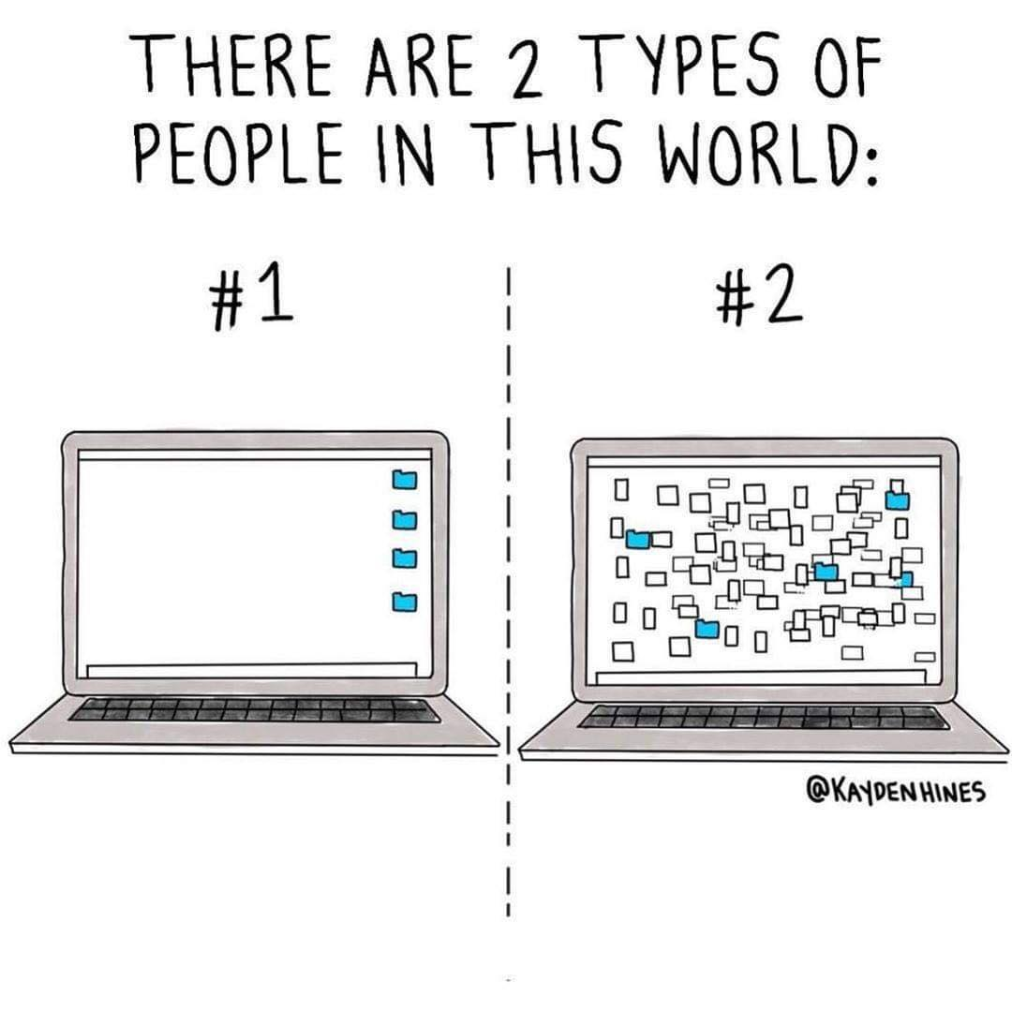
File organization: HOW
How?
Make a file organization plan
Plan folder hierarchy
Develop file naming convention
Develop versioning strategy
Document the file organization system
Use the system consistently
Harvard RDM working group, CC-BY (https://osf.io/hjntb/)

Slide 135
Hierarchy

Slide 136


Plan Folder hierarchy
Identify ways to divide files into categories or attributes
Project: one project = one folder
Date / time
Location
Instrument or method
Project stage
Data type: data (raw vs. processed), processing code, results, findings
What is the most important attribute? -> Top level organization
Create nested folders according to importance / usefulness of category
Avoid overlapping categories and keep file names in mind
Balance: folders not too large vs. structure not too deep
File inventory
Folder hierarchy
Adapted from Harvard RDM working group, CC-BY (https://osf.io/hjntb/)

Slide 137


Creating a systematic file folder hierarchy
Treatment
Assay
01_raw
01_invitro_viability
comp357
01_raw
01_invitro_viability
MTT
comp9001
FACS
Top level organization is for the most important attribute (subjective!)
Adapted from Harvard RDM working group, CC-BY (https://osf.io/hjntb/)
Notes:
Top-level organization should reflect the most important attribute of the data. This is subjective and depends on the context (e.g., treatment type, assay type, experiment date).

Slide 138
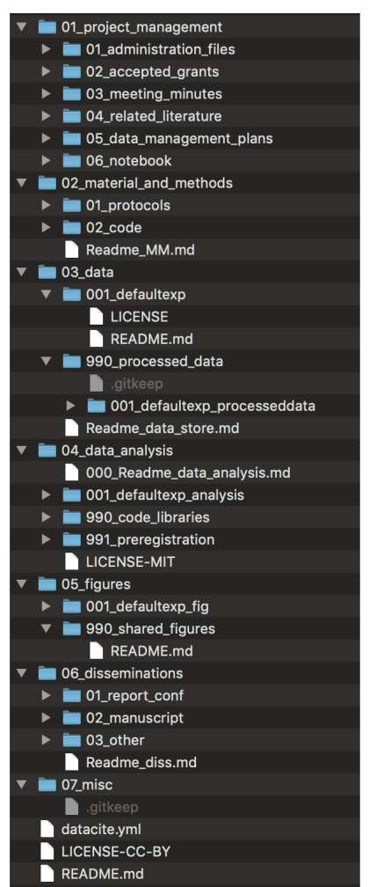
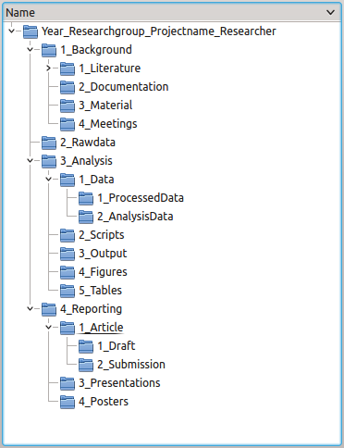
Plan Folder hierarchy: examples
README.txt (project context)
Literature
Data
README.txt (data structure)
01_raw
02_processed
03_analysed (figures and tables)
04_external
Reports
01_draft
02_submission
Meetings
Scripts

Slide 139
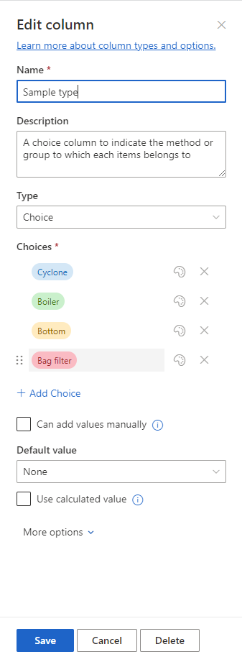
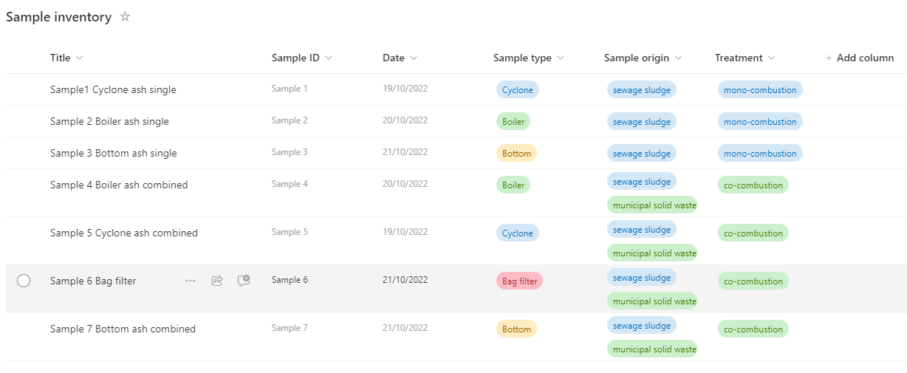
Metadata in sharepoint
Example: Nutrient Recycle RDM workspace
Notes:
Metadata provides structured information about your data files, enabling better organization, discoverability, and usability within the SharePoint environment.
To find and track data & files, filtering and sorting
Nutrient Recycle RDM Workspace:
To demonstrate how SharePoint is used effectively in managing data inventories.
It shows custom metadata fields tailored to project needs.

Slide 140

FOLDERS
METADATA
Location
Time
Location
Time
Belgium
2022
01_raw
01_belgium
2022
Belgium
2023
Belgium, Spain
2023
2023
Spain
2022
Spain
2023
02_spain
Examples:
Folder hierarchy on project share
Library and subfolders on SharePoint site
Examples:
Library on SharePoint site
List on SharePoint site
Notes:
Folder structure:
Hierarchical organization: Data is stored in nested folders based on attributes (e.g. condition, treatment, or other criteria).
Static structure: The arrangement is fixed; finding data often requires knowing the folder hierarchy.
Metadata:
Dynamic labelling: Information about the files is tagged rather than embedded in the structure.
Searchable and flexible: Allows filtering and querying files across categories without navigating through folders.
Supports overlaps: One file can have multiple tags (e.g., a file tagged with both “Belgium" and “Spain").
Key differences:
Flexibility: Metadata allows for multiple classifications per file, unlike the rigid single-path folder structure.
Scalability: Metadata can easily scale with large datasets; folder structures become cumbersome.
Search & filtering: Metadata enables advanced search and filtering across multiple parameters.
SharePoint allows you to combine both approaches (for optimal data management), using libraries to organize and tag files effectively. E.g.:
Use folders for broad, high-level organization (e.g., separating projects or major categories).
Use metadata for detailed and flexible labelling, enabling efficient search, filtering, and cross-referencing.

Slide 141
Folder structure vs. metadata
FOLDERS
METADATA
Condition
Treatment
Condition
Treatment
In vitro
Compound 357
01_raw
01_invitro_viability
comp357
In vitro
Compound 9001
In vivo, In vitro
Compound 357
comp9001
In vivo
Compound 357
02_invivo_viability
In vivo
Compound 9001
Examples:
Folder hierarchy on project share
Library and subfolders on SharePoint site
Examples:
Library on SharePoint site
List on SharePoint site

Slide 142
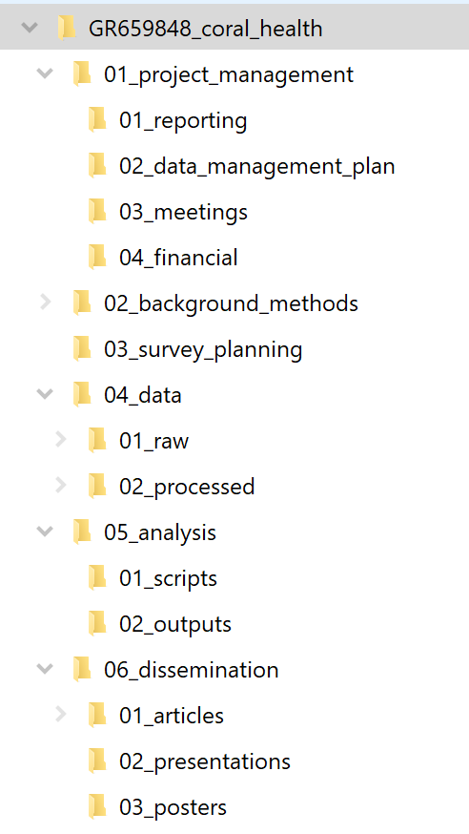
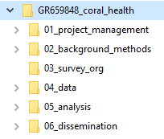
Example

Slide 143
Naming

Slide 144
Creating a file naming schema
File name
Principal identiﬁer of ﬁle, used to uniquely identify a file
Should let you know what the content of the file is
Should be made of a few descriptive elements & keywords
What do you include?
[ ? ]_[ ? ]_[ ? ].xlsx
What keywords, elements or unique characteristics would be best to reflect the content of your file?

Slide 145
Creating a file naming schema
Concatenate relevant elements to create a file naming schema.
Think about which order do you want them sorted in your folder?
[ ? ]_[ ? ]_[ ? ].jpeg
MTT_COMP357_WT_20190415_IMG0001.jpeg
20190415_IMG0001_ MTT_COMP357_WT.jpeg

Slide 146
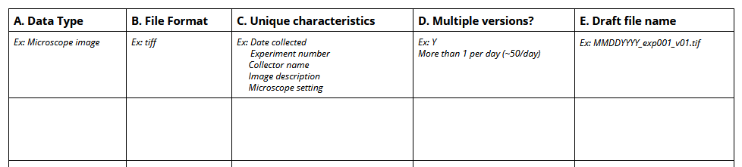
Creating a file naming schema

Slide 147
File naming: Best practices
LENGTH | Avoid long names, remove unnecessary elements
SPECIAL CHARACTERS |   | Spaces Special characters: \ / : * ? " < > | ! % & - ; = () + , . Underscores camelCase |   | name date v1.txt name.date.v1.txt name/date&v1.txt name_date.txt nameDate.txt
DATES |  | Use ISO8601 YYYYMMDD |  | 20201008_name_v01.txt
NUMBERING |  | Use leading zeroes for sequential numbering |   | nameDate_1 nameData_001.txt, nameDate_010.txt

Slide 148
File naming: examples
FG1_CONS_20150309.rtf
Interview transcript of the ﬁrst focus group with consumers, on 2015-03-09
GC-MS1_20180912_POLY03.ms
Polymer 3 measured on GC-MS machine 1 on the September 12 2018​
FMHSurvey_Procedures_04.docx
Version 4 of the survey procedures for the Flemish Mental Health survey
Health & Safety Procedures1 (no extension)
Spaces, special character and no extension​
SrvMthdDraft.doc, SrvMthdFinal.doc, SrvMthdFinalV4.doc
Use consistent versioning, unable to identify the real last one​
Focus Group consumers 12+13 Feb.mp3
Spaces and special character​
mydata.txt, script.R, analysis.py
Unique?​
Notes:
Afbeelding: duim omhoog en duim omlaag

Slide 149
Develop file naming convention
Think of the current and expected files
Use unique characteristics reflecting the file content, possibly status and version​
File name = principal identiﬁer of ﬁle, used to uniquely identify a file​
Be consistent
Data type | Unique characteristics | Multiple files or versions? | File format | Draft naming schema
Microscope image | Date collected Experiment number Sample type Microscope settings | >50 images per day | TIFF | YYYYMMDD_exp01_samplecode_001 YYYYMMDD_samplecode_exp01_001
Adapted from Worksheet: Naming and Organizing your Files and Folders by MIT Libraries Data Management Services, CC-BY,
Notes:
Steps to organize files:
Make a file organization plan:
Plan folder hierarchy: define a logical structure (e.g., by project, year, or category).
Develop file naming conventions: use clear, consistent names (e.g., ProjectName_Date_v1.docx).
Develop a versioning strategy: use version numbers or dates to track changes (e.g., v1, v2, or Final).
Document the file organization system: create a guide or document to explain the structure and conventions to yourself and collaborators.
Use the system consistently: stick to the plan for all new files and folders to ensure long-term organization.

Slide 150
Tools for bulk renaming
Windows:
Ant Renamer (www.antp.be/software/renamer)
Bulk Rename Utility (www.bulkrenameutility.co.uk/)
Total Commander (https://www.ghisler.com/deutsch.htm)
Mac:
Renamer 5 (for Mac) (https://renamer.com/)
Name Changer (https://mrrsoftware.com/namechanger/)
ExifRenamer (https://www.qdev.de/?location=mac/exifrenamer)
Linux:
GNOME Commander (www.nongnu.org/gcmd/)
GPRename (http://gprename.sourceforge.net/)
Unix:
Rename command
From: https://doi.org/10.5281/zenodo.1212496

Slide 151
Version

Slide 152

Version control
WHAT: continuously making records of data and files as you work on them
WHY:
to locate correct version;
to track history (what, when, who, why);
to review changes;
to avoid data loss

Slide 153
Version control
HOW
When writing a paper
Track changes
Office or Sharepoint history
Understandable, systematic file names
When describing methods
Protocol in word (see above)
Analysis scripts in git or similar
When processing/analyzing data
Git or similar
Understandable, systematic file names
When publishing/reporting data
Unique and persistent identifiers
Documented and stable version numbers in data repository or git
WHAT
continuously making records of data and files as you work on them
WHY
to locate correct version
to track history (what, when, who, why)
to review changes
to avoid data loss
Notes:
What
Continuously making records of data and files as you work on them.
Why
To locate the correct version of a file.
To track the history of changes (what, when, who, why).
To review changes made over time.
To avoid data loss.
How
When writing a paper:
Use Track Changes in Word or equivalent tools.
Use Office or SharePoint version history.
Adopt clear, systematic file naming conventions.
When describing methods:
If you write protocols in Word, use versioning features described above.
Use Git or similar tools for analysis scripts.
When processing/analyzing data:
Use Git or other version control tools.
Ensure file names are clear and systematic.
When publishing/reporting data:
Assign unique and persistent identifiers (e.g., DOIs).
Use stable version numbers in data repositories or Git to ensure reproducibility.
Key takeaway
Implementing version control is essential for managing changes, improving collaboration, and ensuring data integrity throughout the research lifecycle.

Slide 154
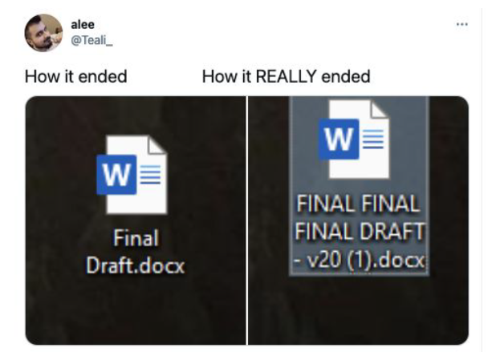
Version control – strategies
Manual change log
Automatic change log (tools, software, platforms)

Slide 155
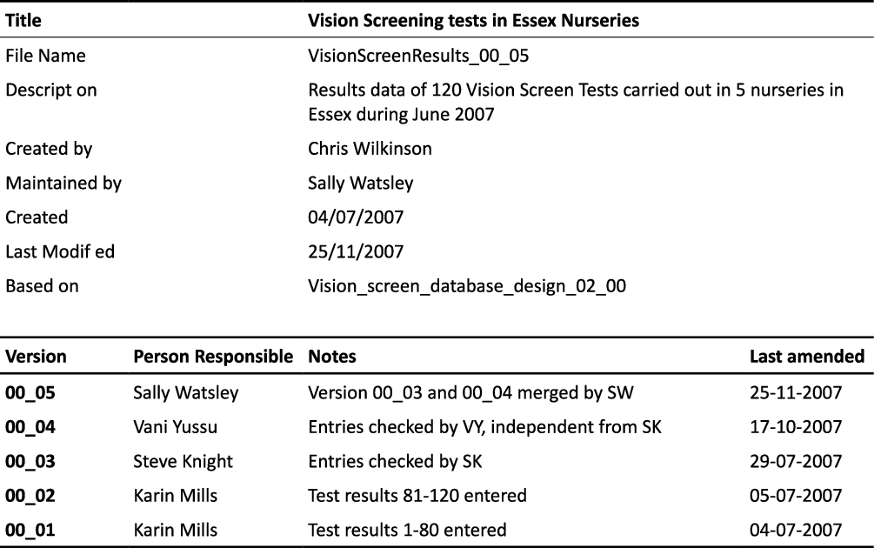
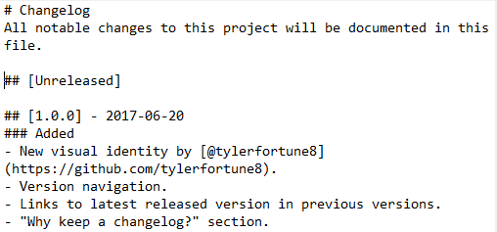
Manual change logs
Record versions, dates, authors and details of changes to ﬁles
1. File name:
based on date: HealthTest_20080406.docx
based on version number: HealthTest_v02.docx
3. Version control table within document
2. File header
https://keepachangelog.com/en/1.0.0/

Slide 156
Version control – best practices
When possible, use platforms with automatic change logs
If not,
identify milestone versions of ﬁles to keep.
avoid clutter
use a systematic naming convention
record version and status (e.g. raw, cleaned) of a data ﬁle
When collaborating
use a common ‘workspace’ (e.g. shared folder) to avoid different versions of ﬁles on different locations
do not use e-mail to share data

Slide 157





Automatic change logs
Version control can also be maintained through:
Version control functionality within software (e.g. MS Ofﬁce)
Cloud storage with version control (e.g. OneDrive, Sharepoint)
Special purpose platforms (e.g. Open Science Framework)
Version control software (e.g. Git and Github)

Slide 158
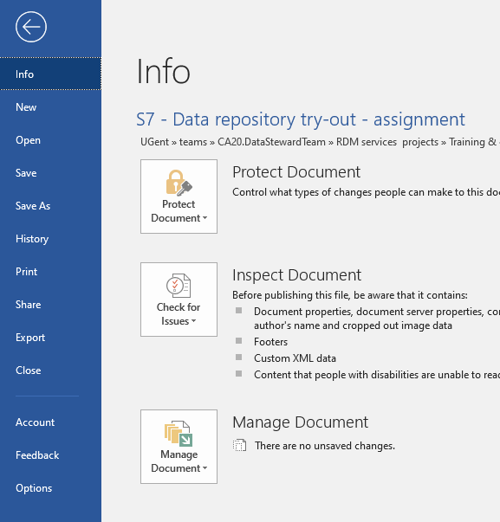
Version control in M365 (sharepoint / onedrive)
Learn more: View previous versions of Office files

Slide 159
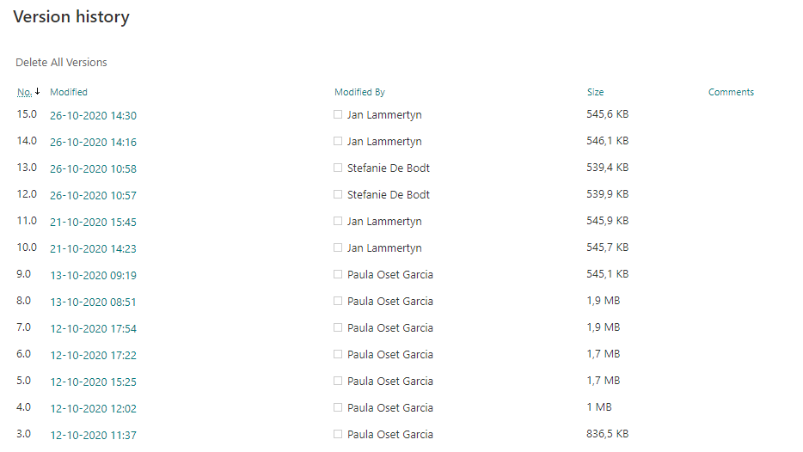
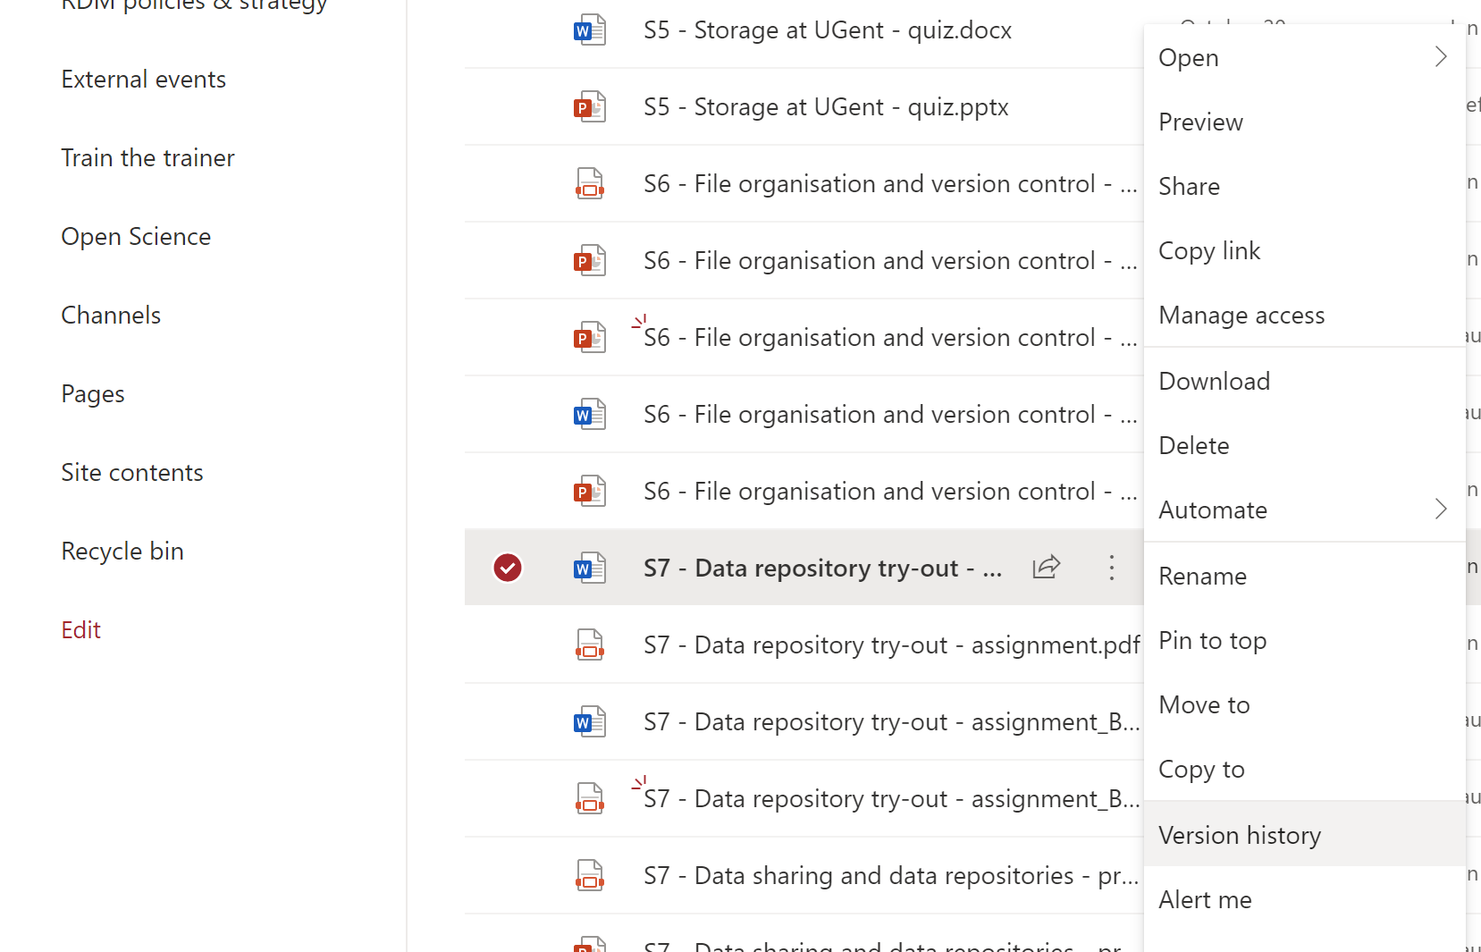
Cloud storage with version control
Do not use version numbers in file names
Learn more: How versioning works in Sharepoint lists and libraries

Slide 160
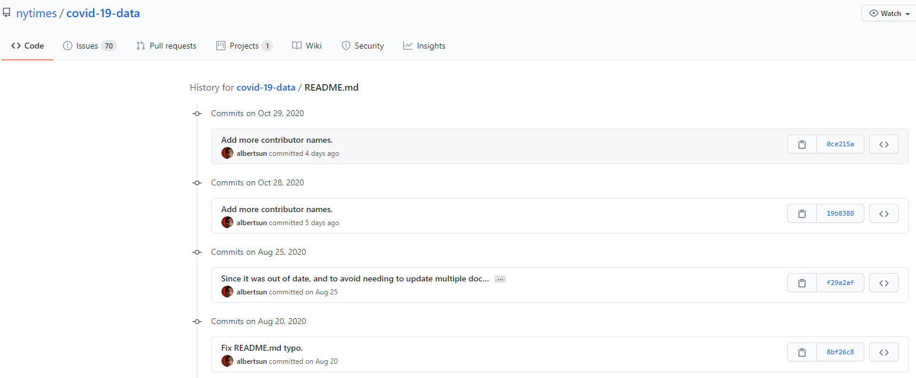
Version control in github

Slide 161
Take-home messages
Organization is a key aspect of data management
Keep the project on track by saving time and storage, and prevent data loss
Plan!
Create* a folder structure, decide on file naming, think about versioning and document what you decided
*or apply an approach decided by your department

Slide 162
Time to get your hands dirty

Slide 163
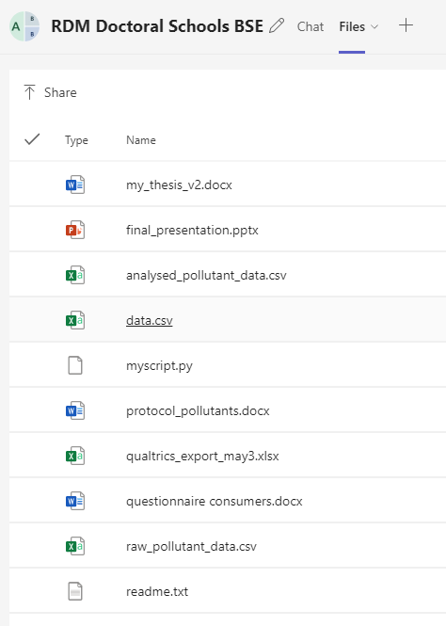
Organize sewage sludge files in folders
Download files
Create a folder with your name: SURNAME_NAME within the corresponding library in the OneDrive site
Revise file names and improve if necessary
Develop folder hierarchy and organize files in folders

Slide 164
Tips: File naming and organization
Part A. Defining your organizational needs
Preferably at the start of the project but it is never too late.
Reflect on current approach to organize (folder structure) and name files. Who are you designing the system for?
Part B. Creating a file naming schema
Part C. Creating a systematic file folder hierarchy

Slide 165
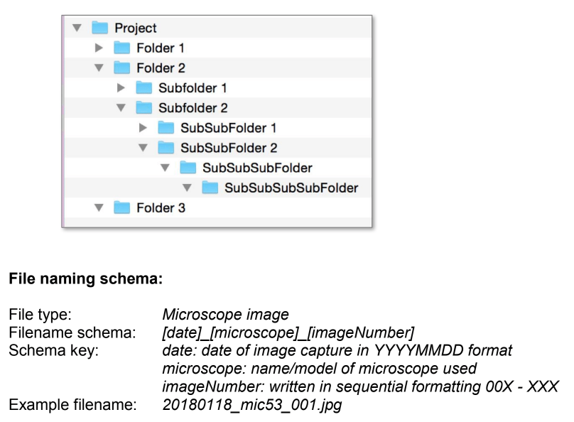
document the file organization system
File naming convention: create a high-level inventory table for the different data types (DMP)
Folder hierarchy: describe reasoning and give examples
Version control: manual or automatic, if manual how?

Slide 166
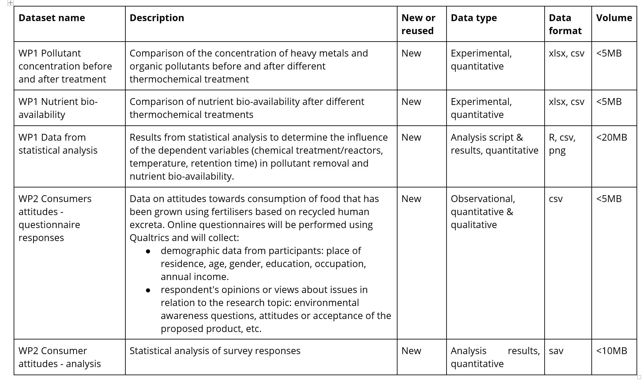
Sewage sludge project

Slide 167
Last message
It’s all about people.
Notes:
One of the reasons we keep doing trainings in person is to bring people together. Professors have asked that specifically from us.
The most important articles I published came all from collaborations I would never imagined, from people I met in trainings just like this. I even met my wife like this…
So be mindful of the people around you, as we seen today, maybe they can help you out. Either by the fact that you shared a trauma here today or that you have the same RDM love.

Slide 168
Matheus Lourenço
Matheus.lourenco@vib.be

